Slide 1
Welcome to St. Mary’s Open Day

Slide 2
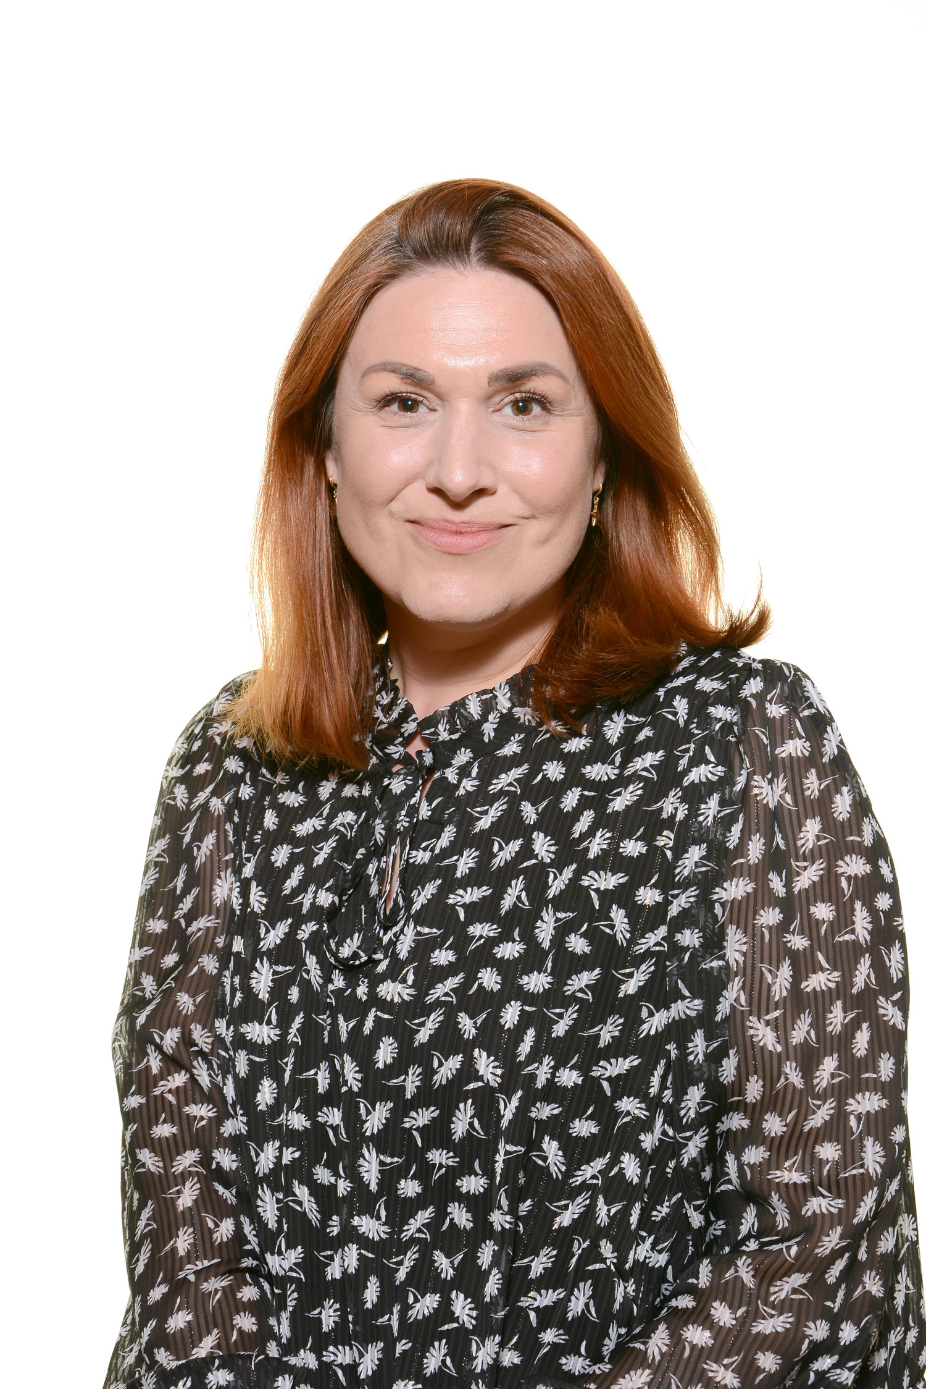
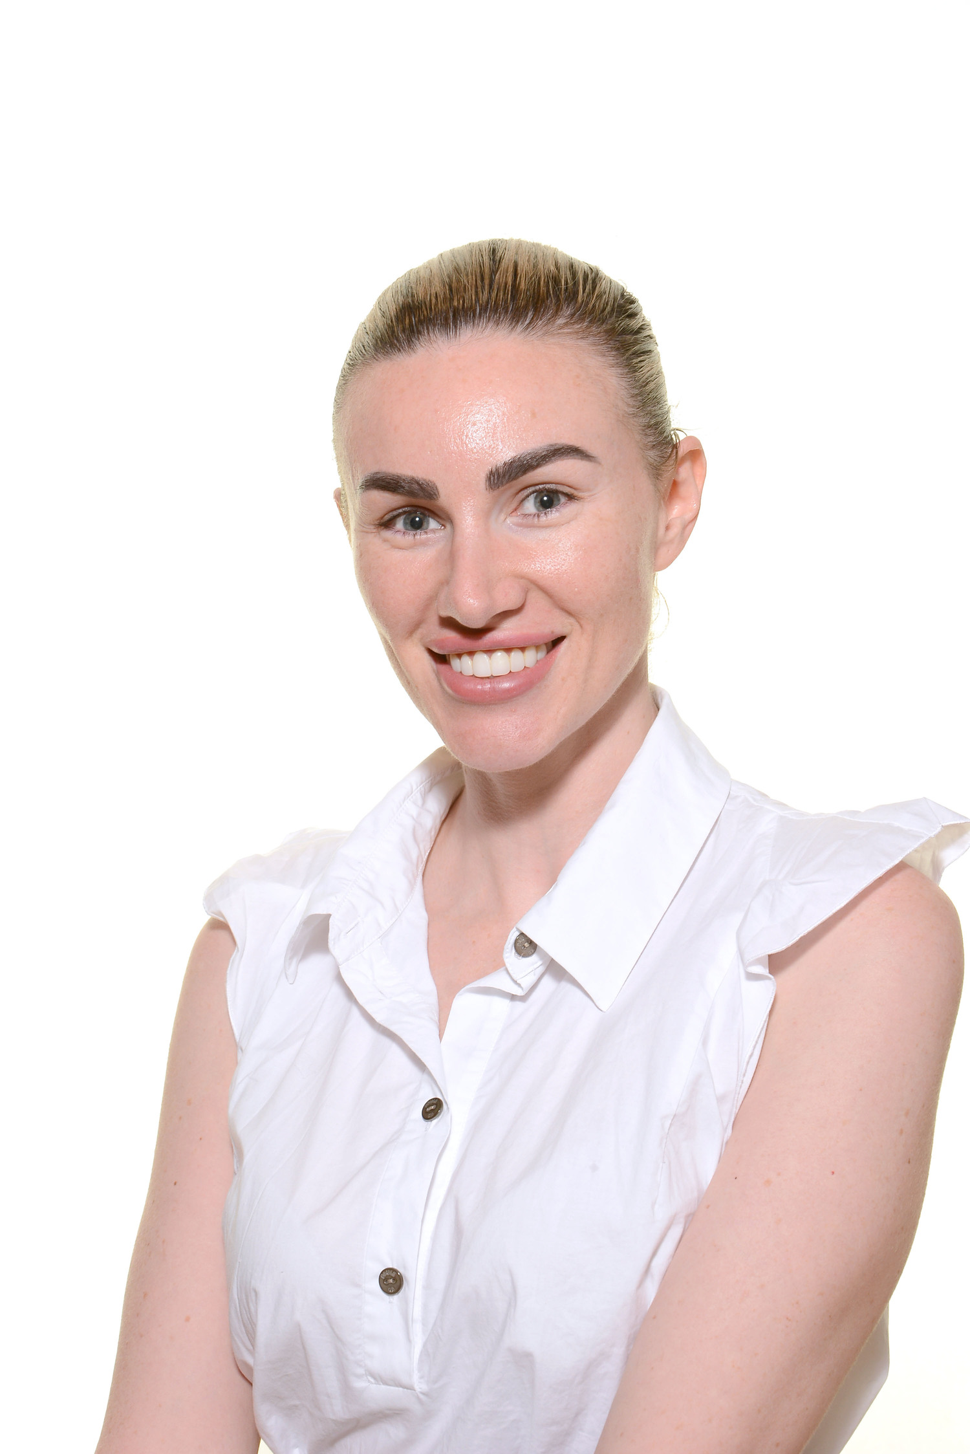
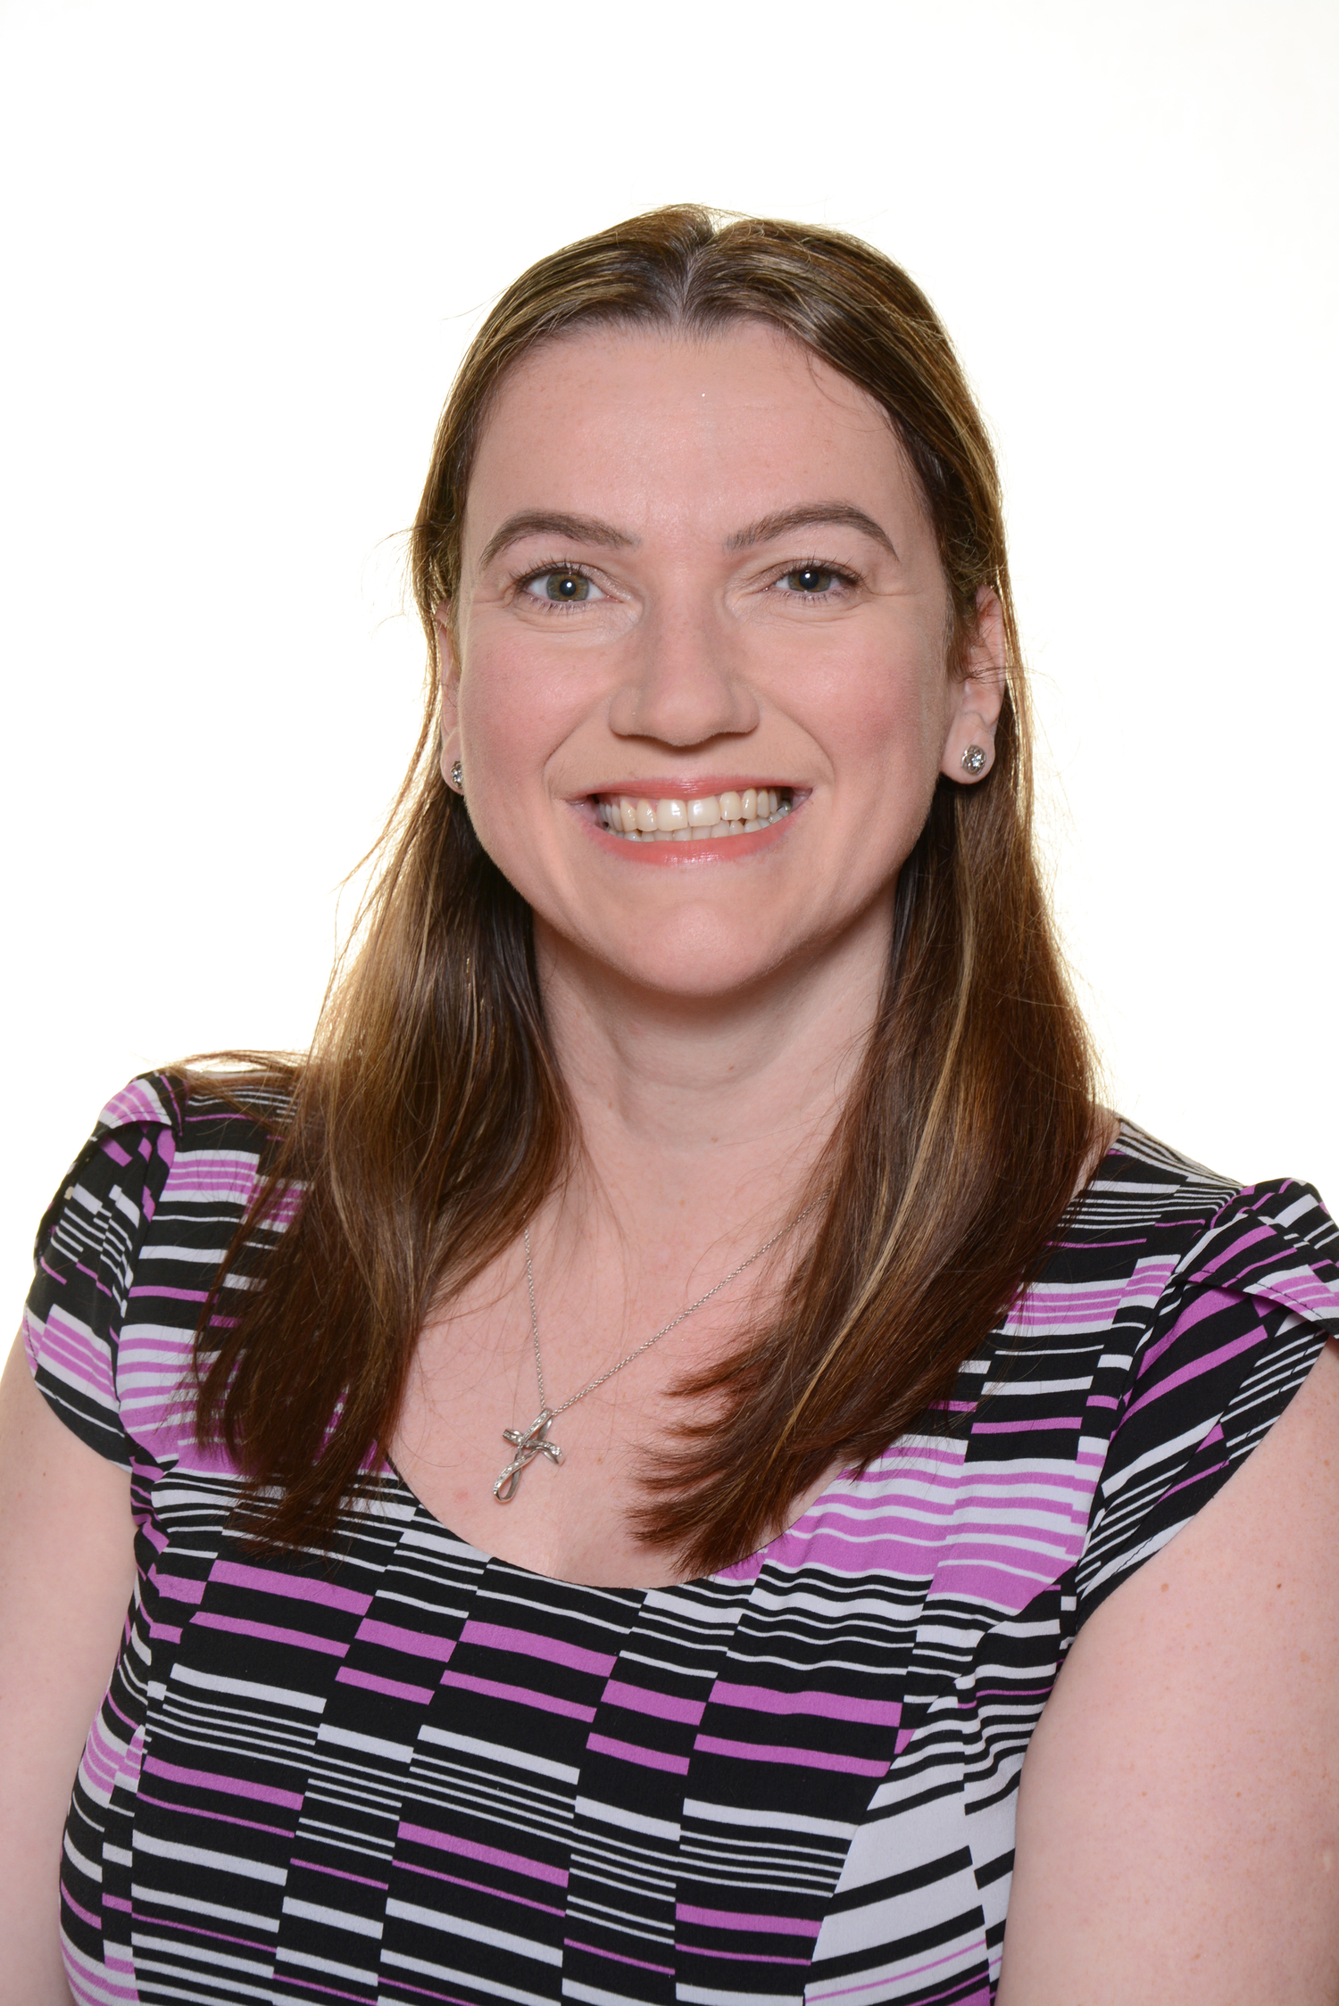
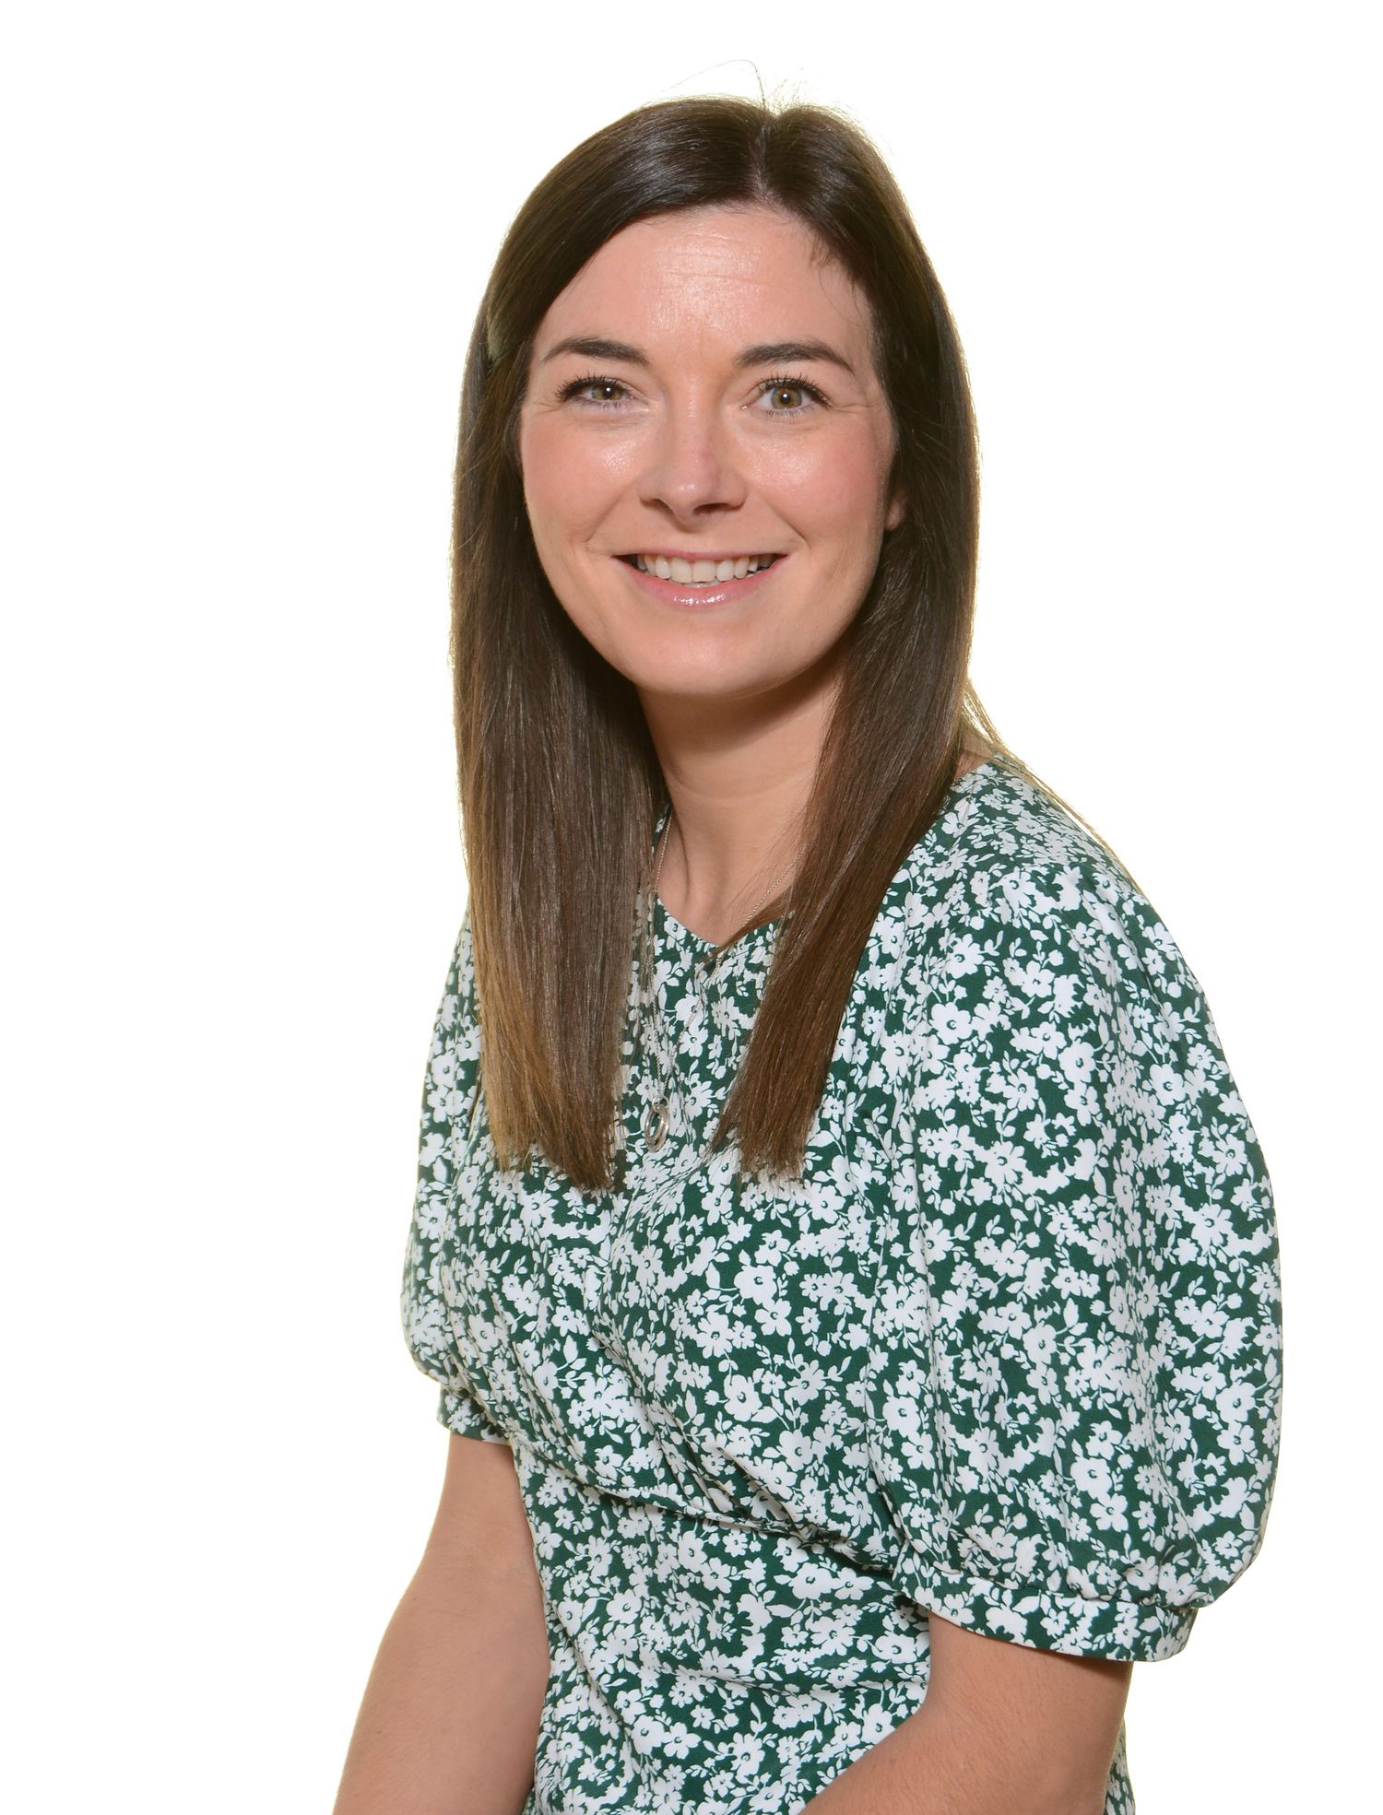
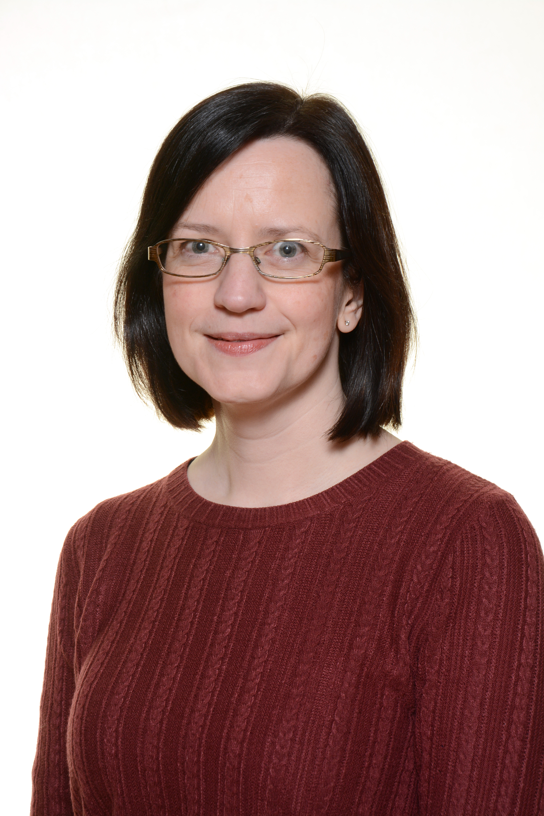
SLT
Mrs Yorke Mrs Davis Mrs Noone Miss Preedy Mrs Jones
Headteacher Deputy Headteacher AHT AHT Senior Teacher

Slide 3
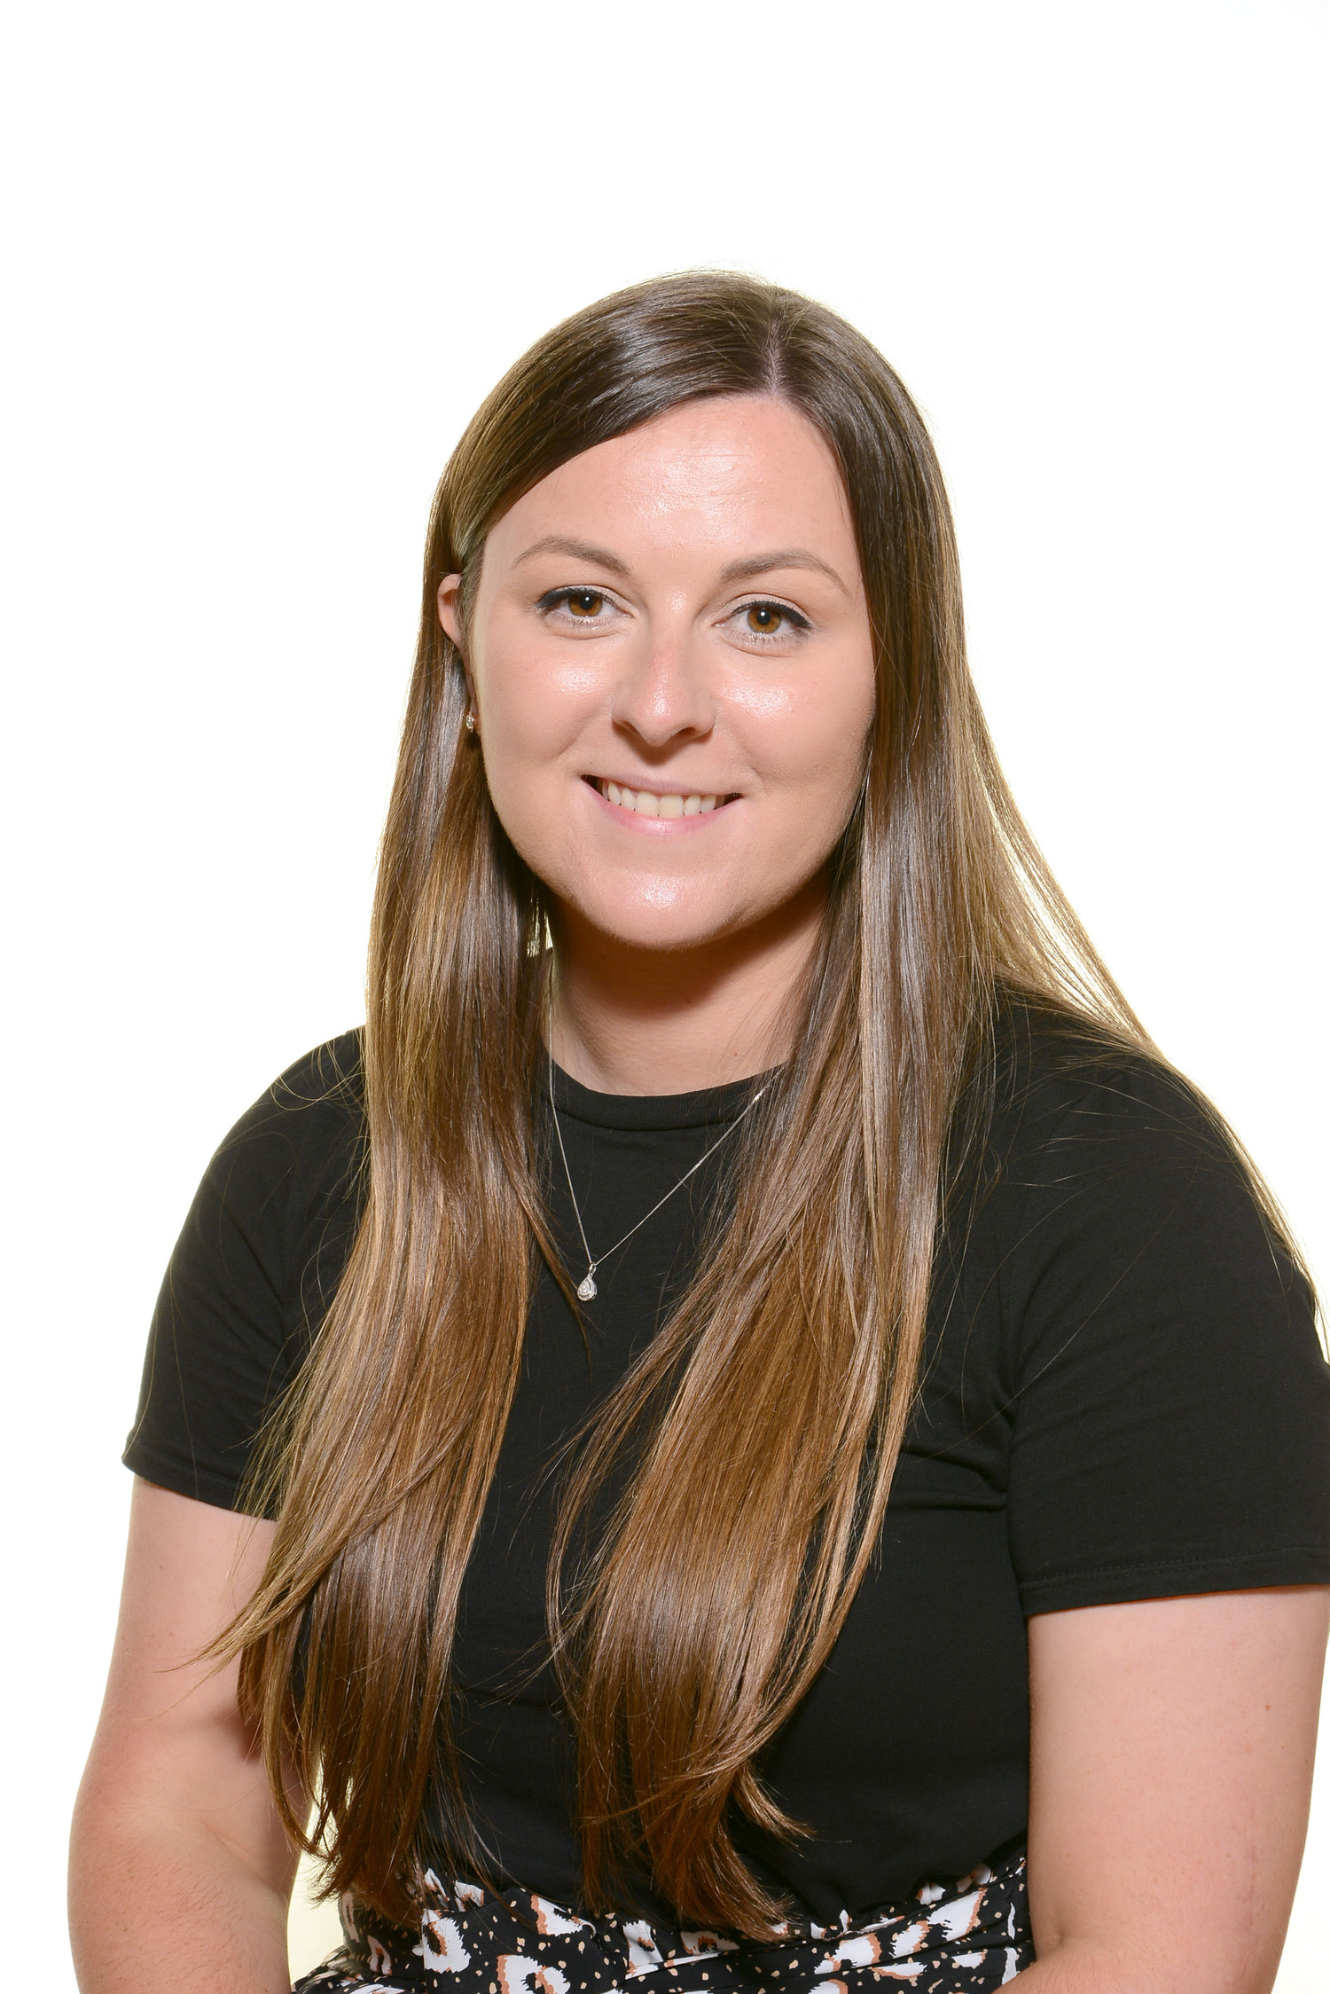
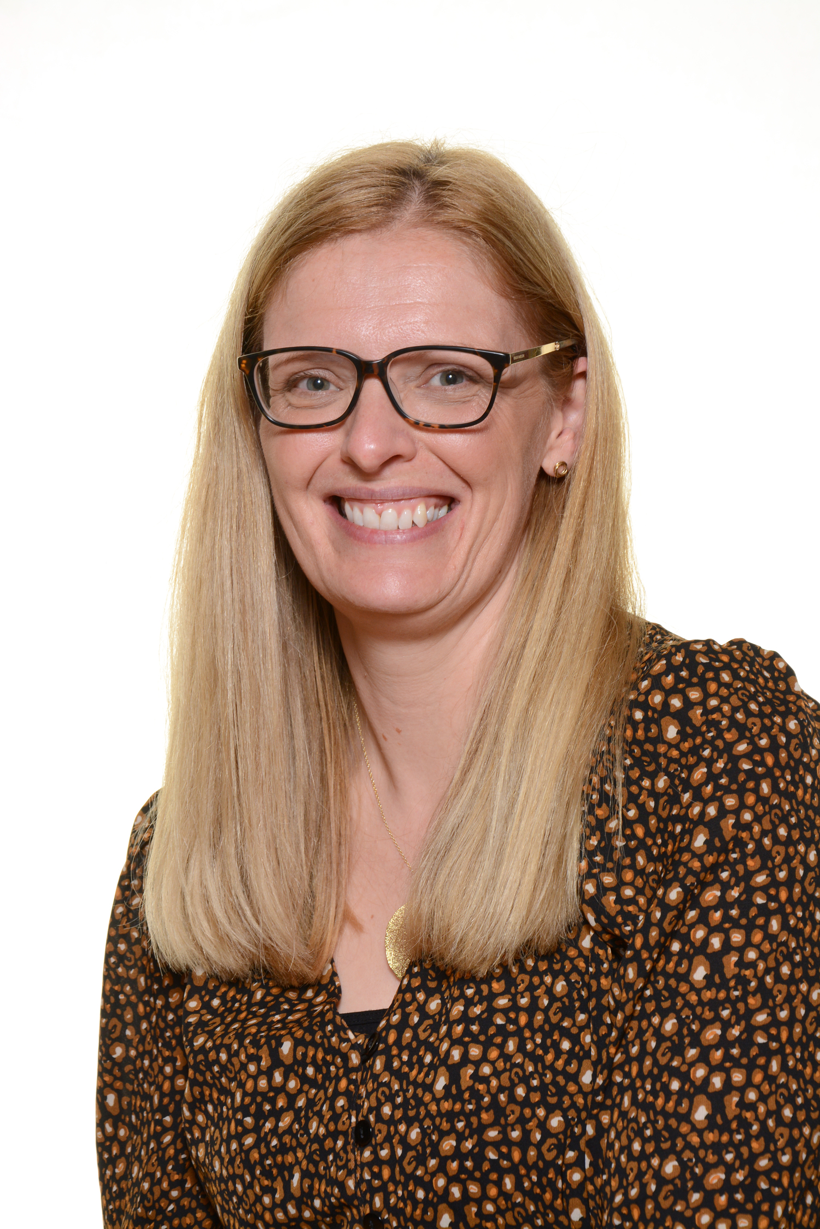
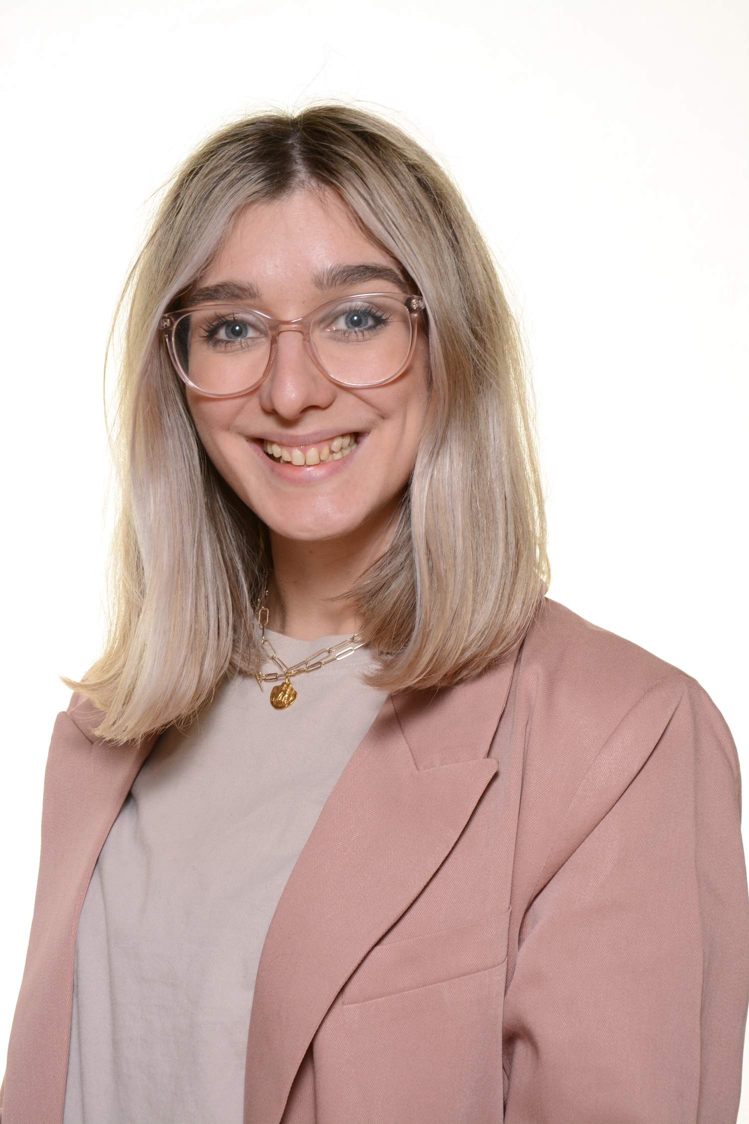
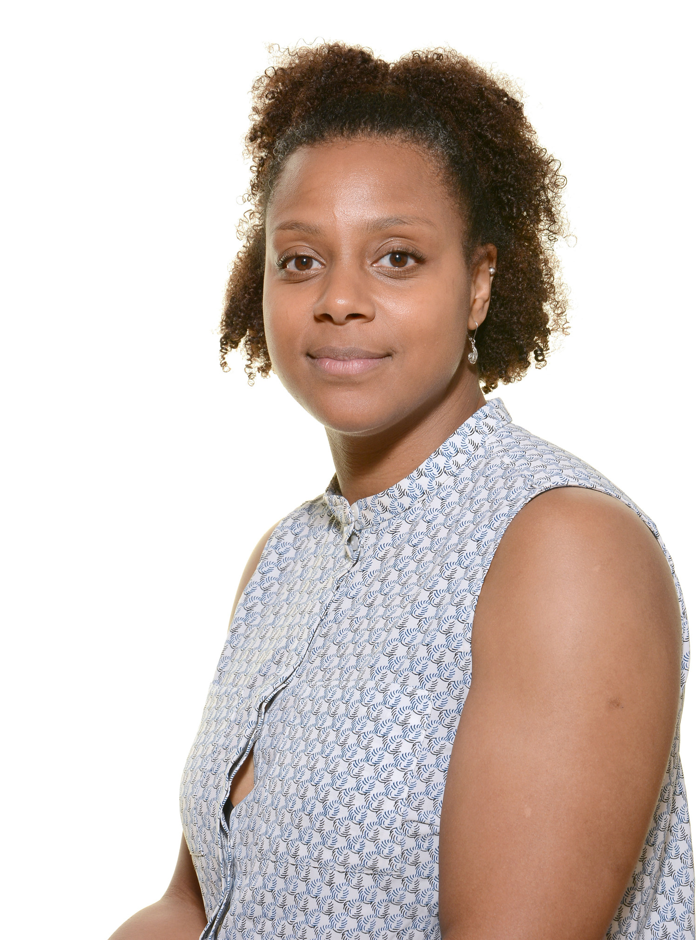
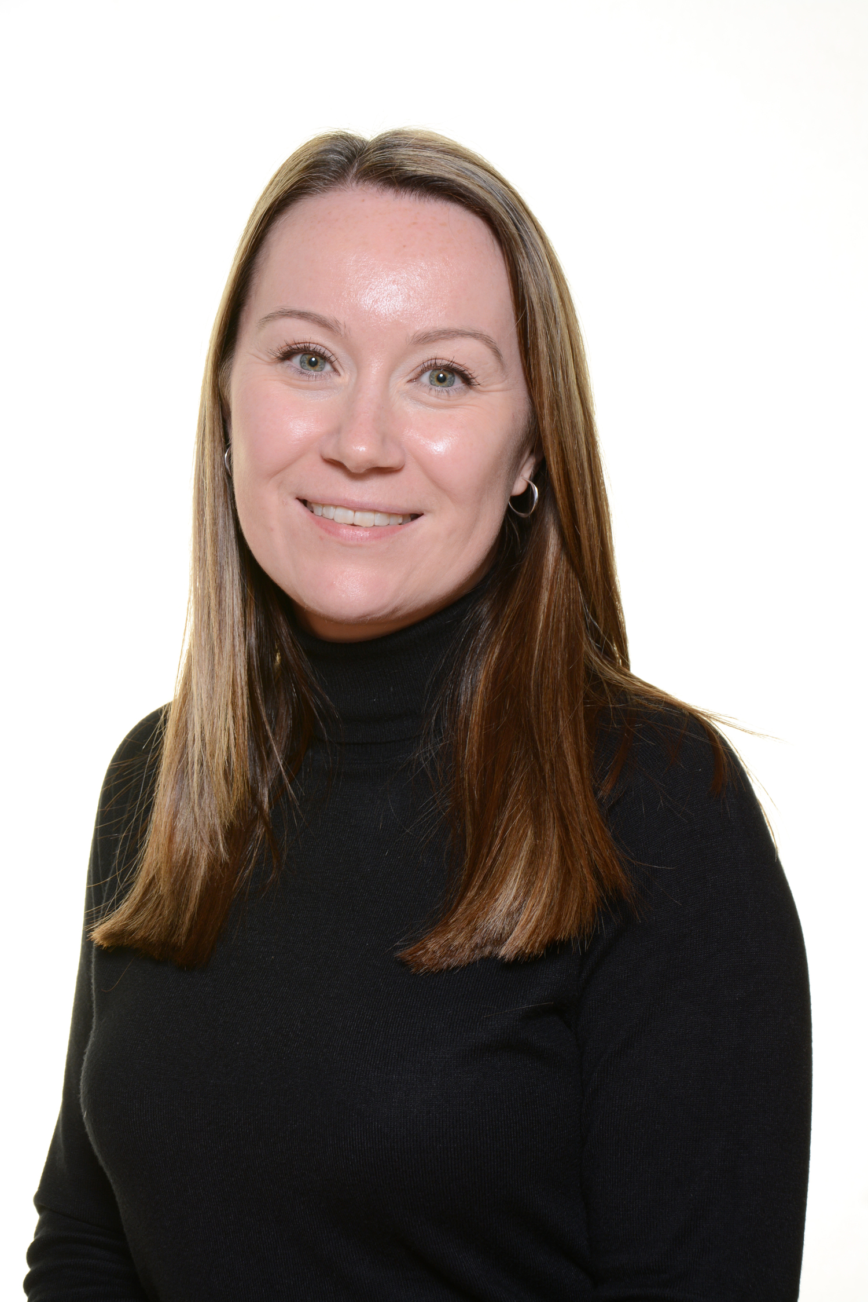
Key Adults
EYFS
Mrs Richards Mrs Russell Miss Detheridge Mrs Campbell Mrs Pitt
YRT Teacher (p/t) YRT Teacher (p/t) YRB Teacher YRT TA YRB TA
EYFS Lead

Slide 4
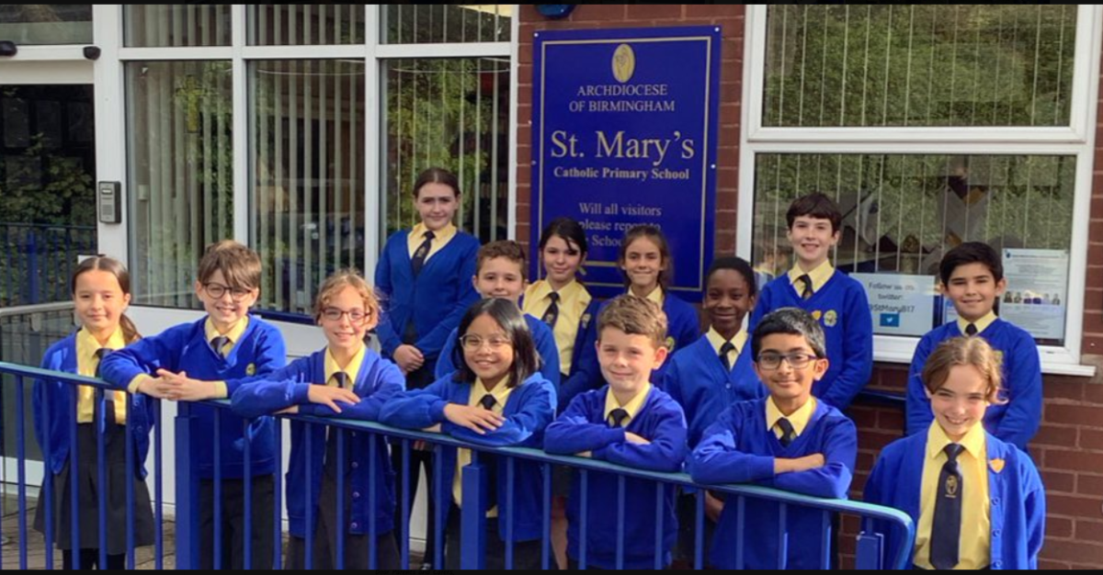
What to expect at St Mary’s…

Slide 5
OUR MISSION
TO LOVE GOD ABOVE ALL THINGS
BY LEARNING TOGETHER LOVING OURSELVES LOVING EACH OTHER LOVING ALL PEOPLE LOVING LIFE ITSELF
AND
CONSTANTLY STRIVING FOR EXCELLENCE WORTHY OF OUR GOD GIVEN GIFTS.

Slide 6
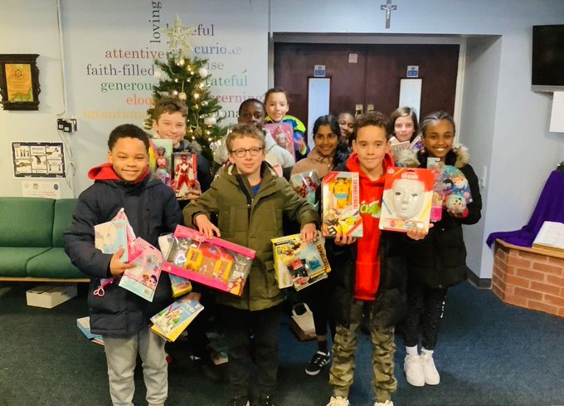
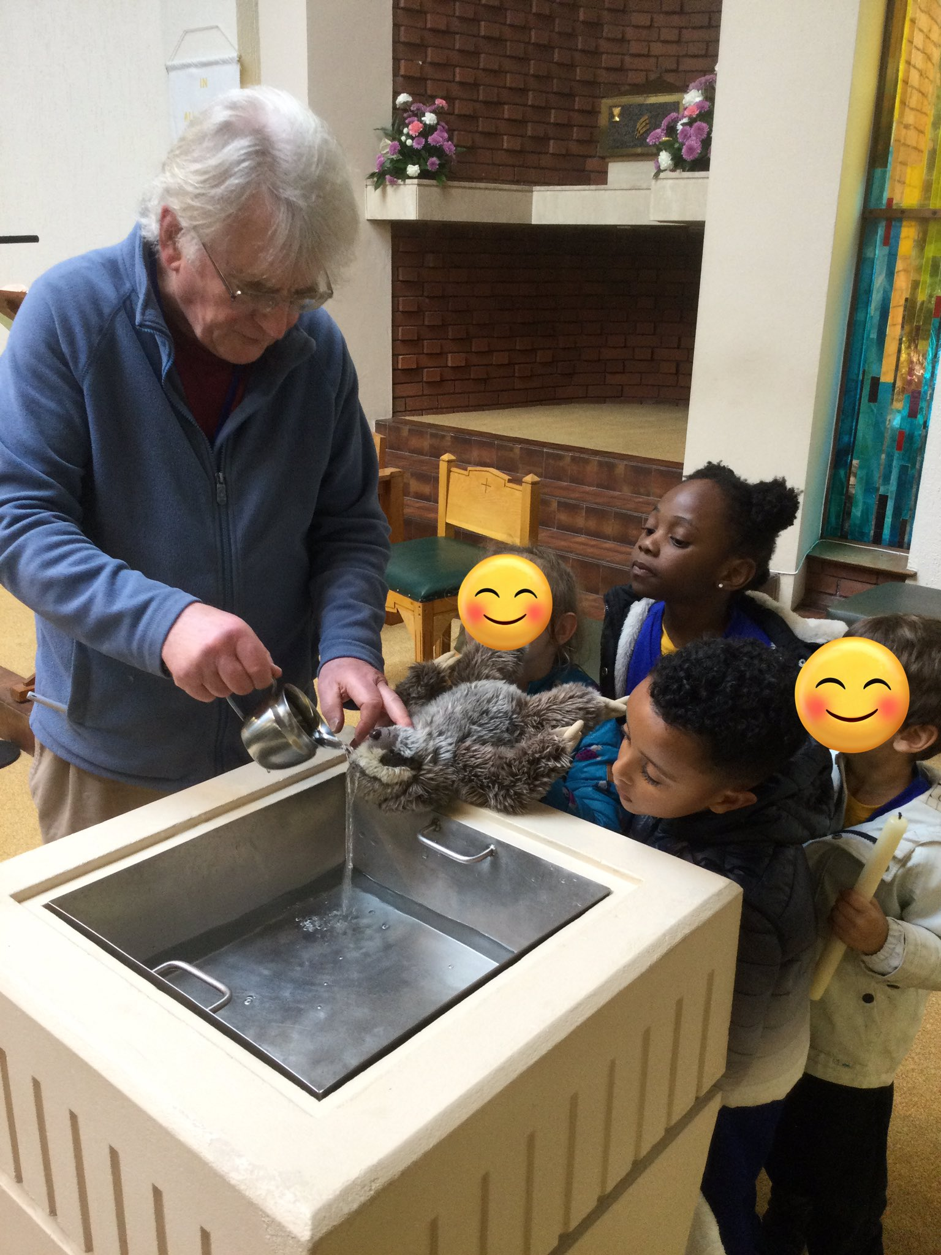
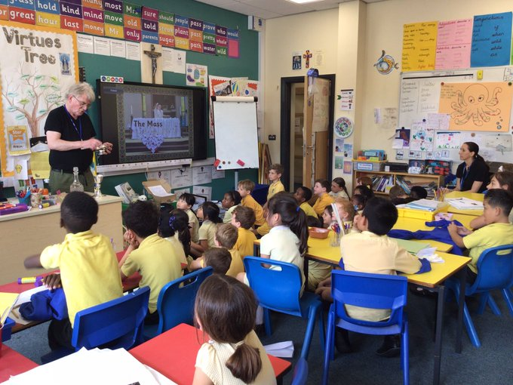
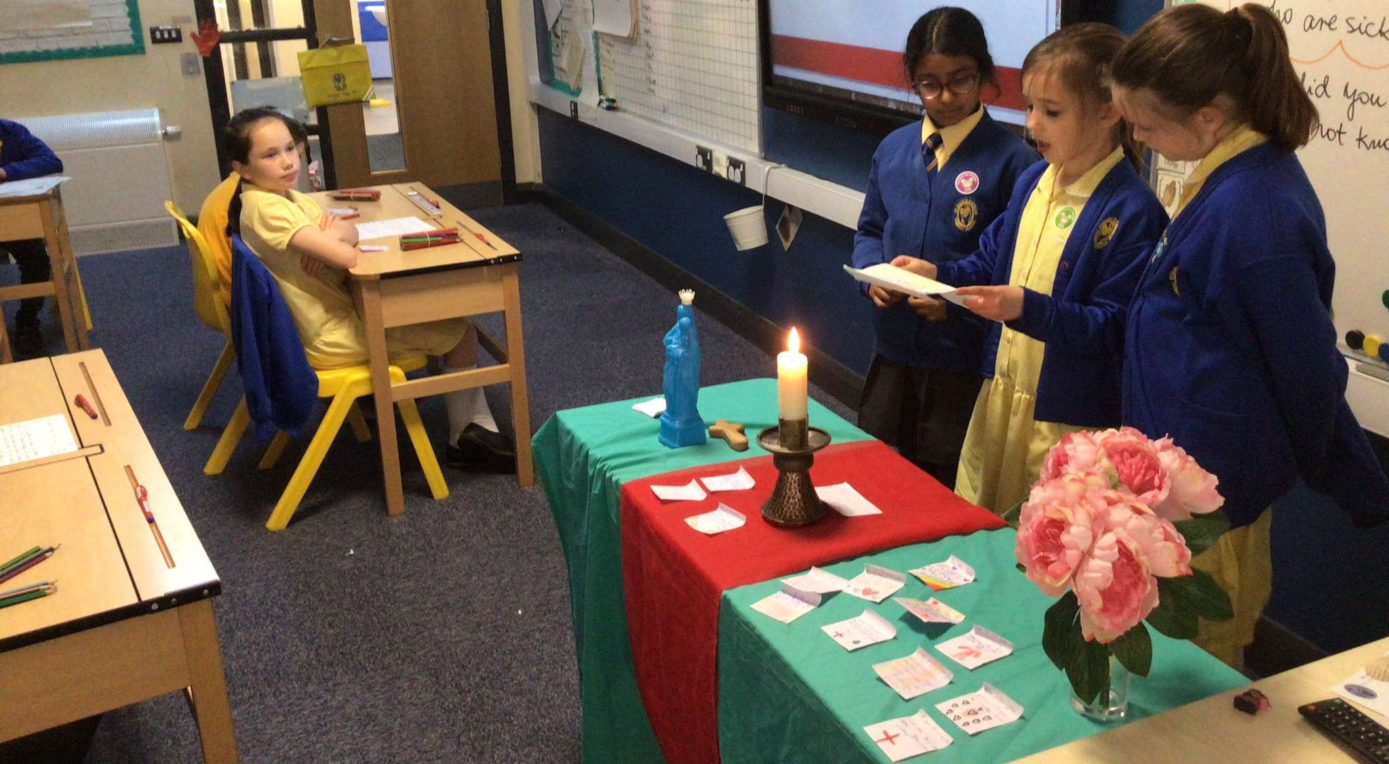
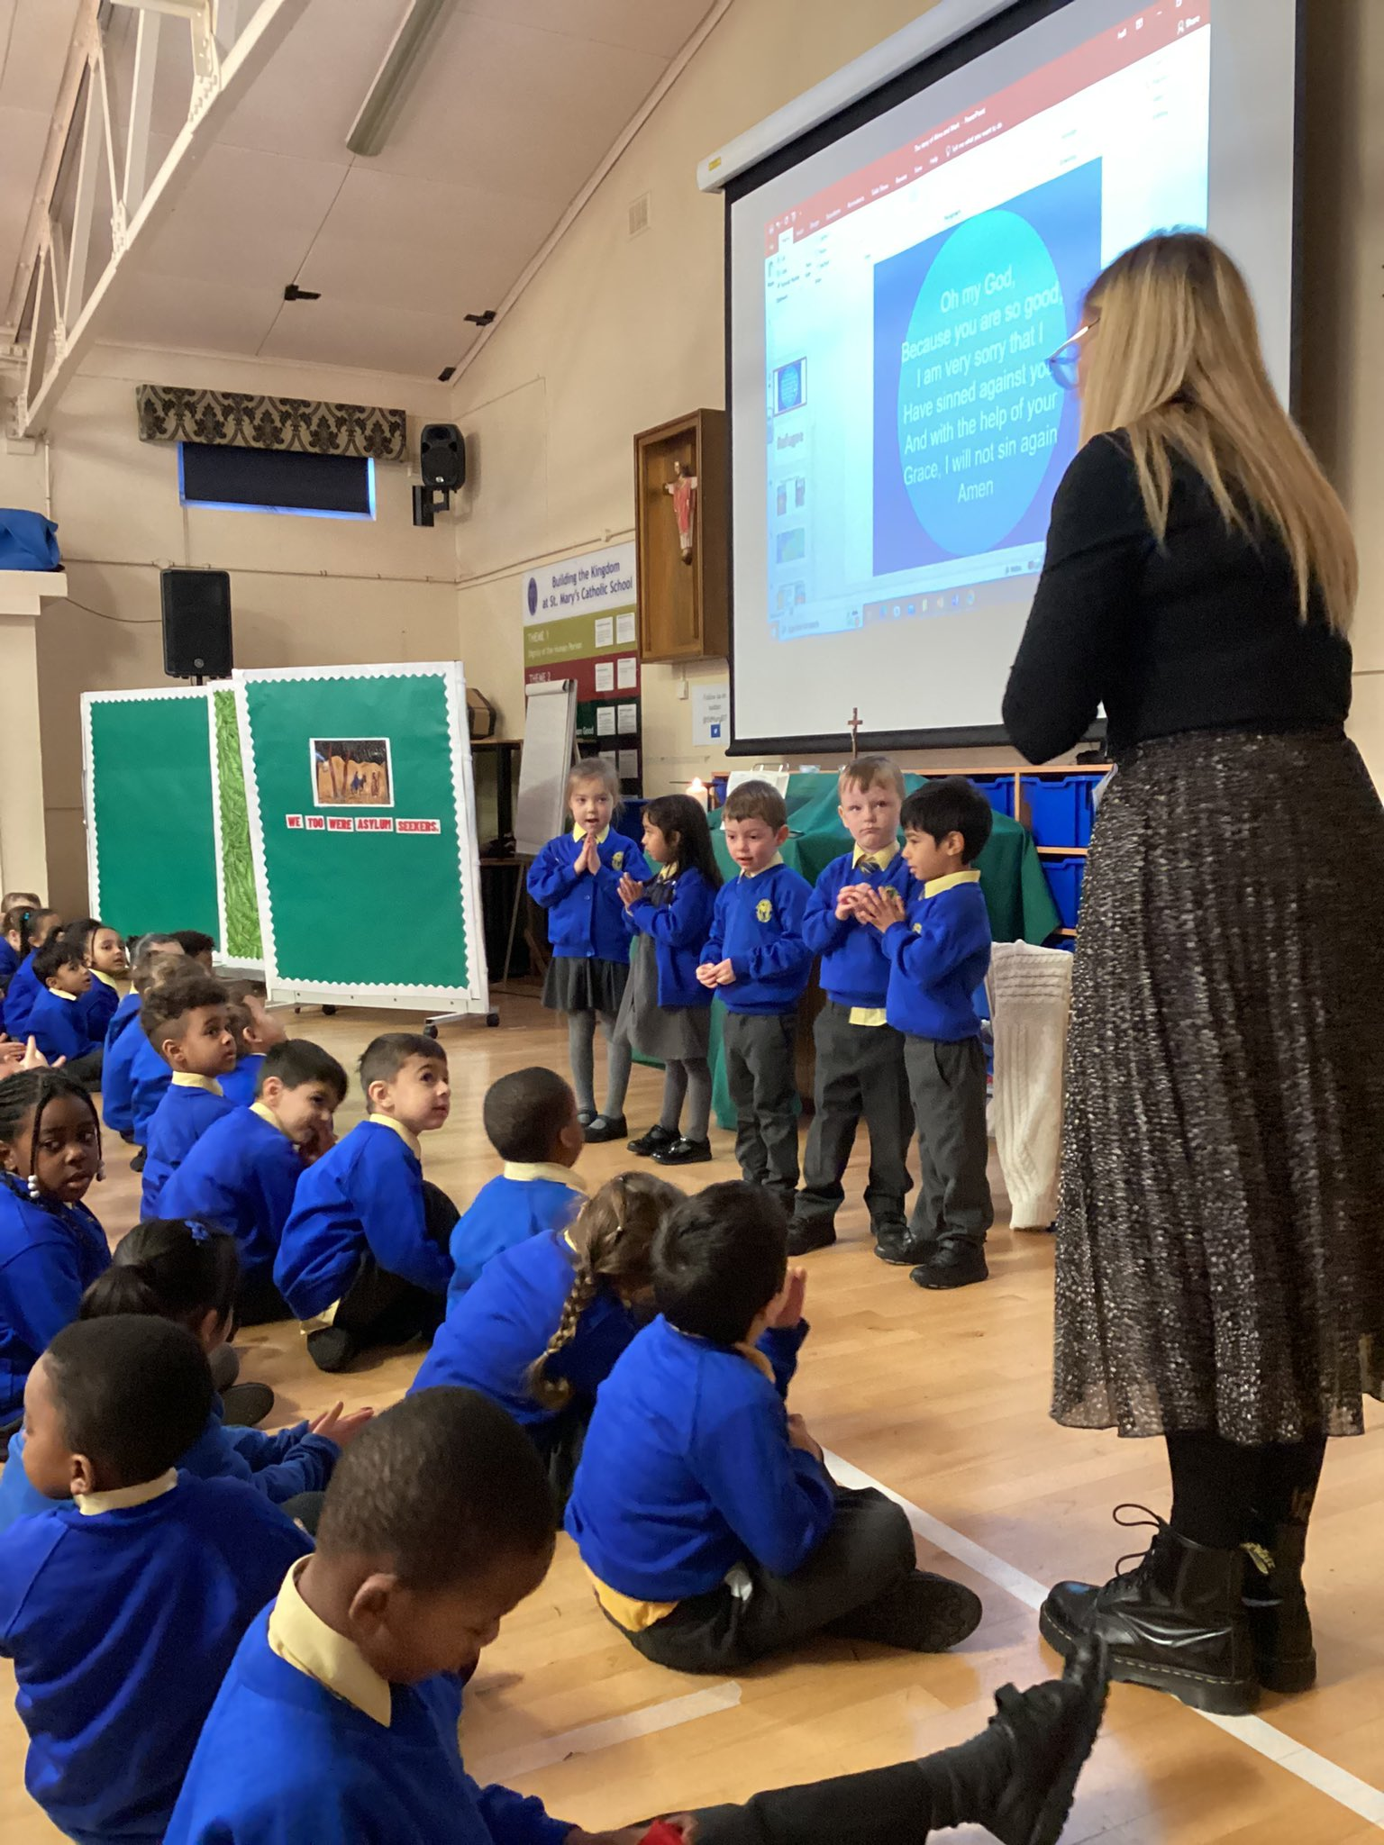
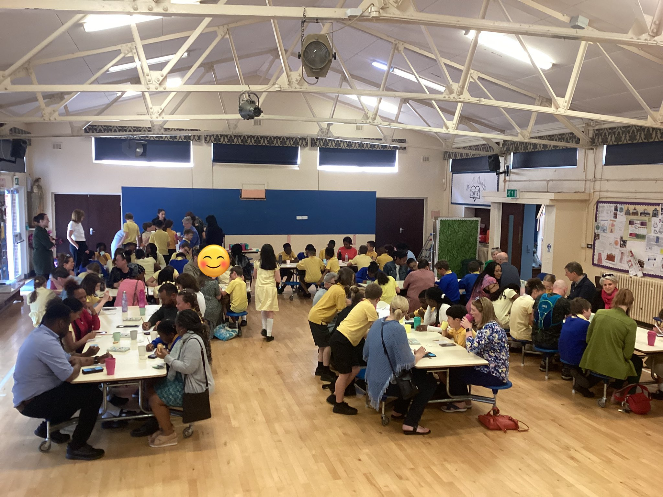
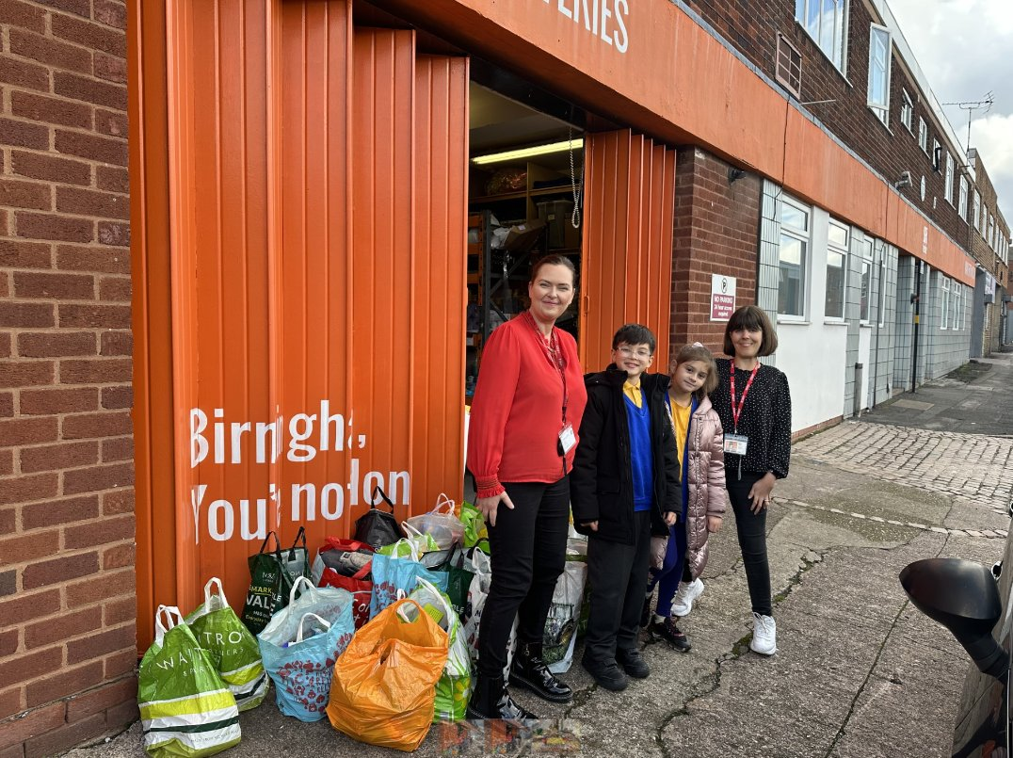
Catholic Life at the heart of everything

Slide 7
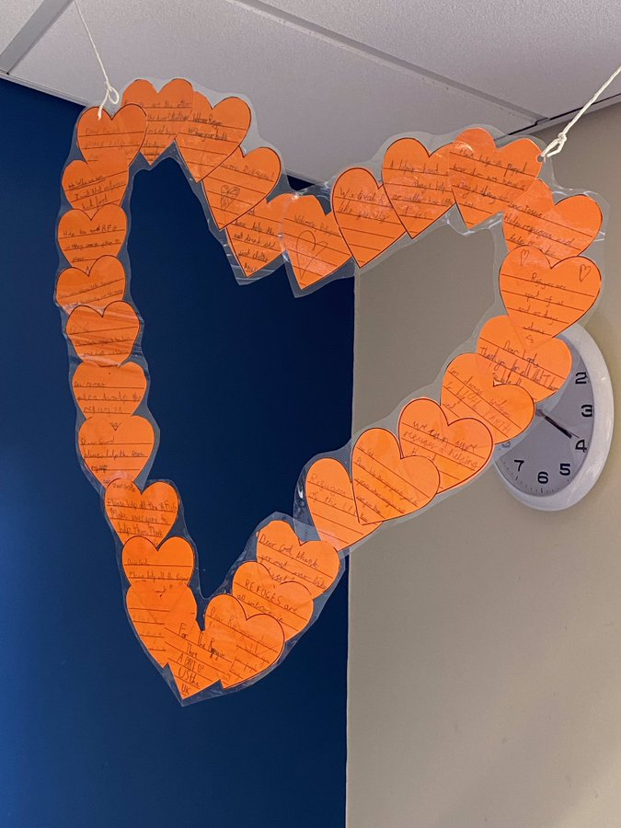
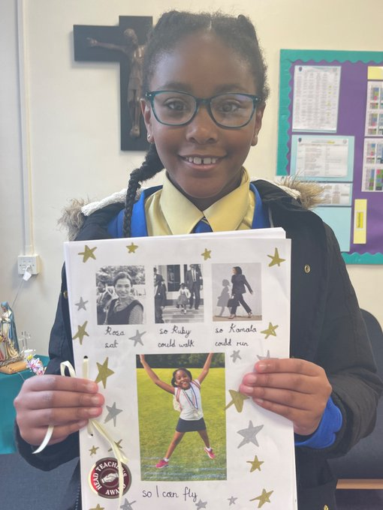
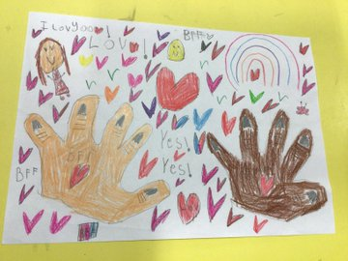
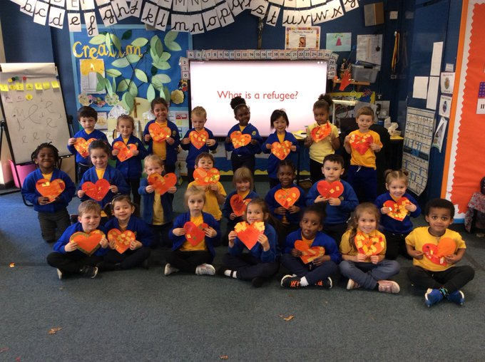
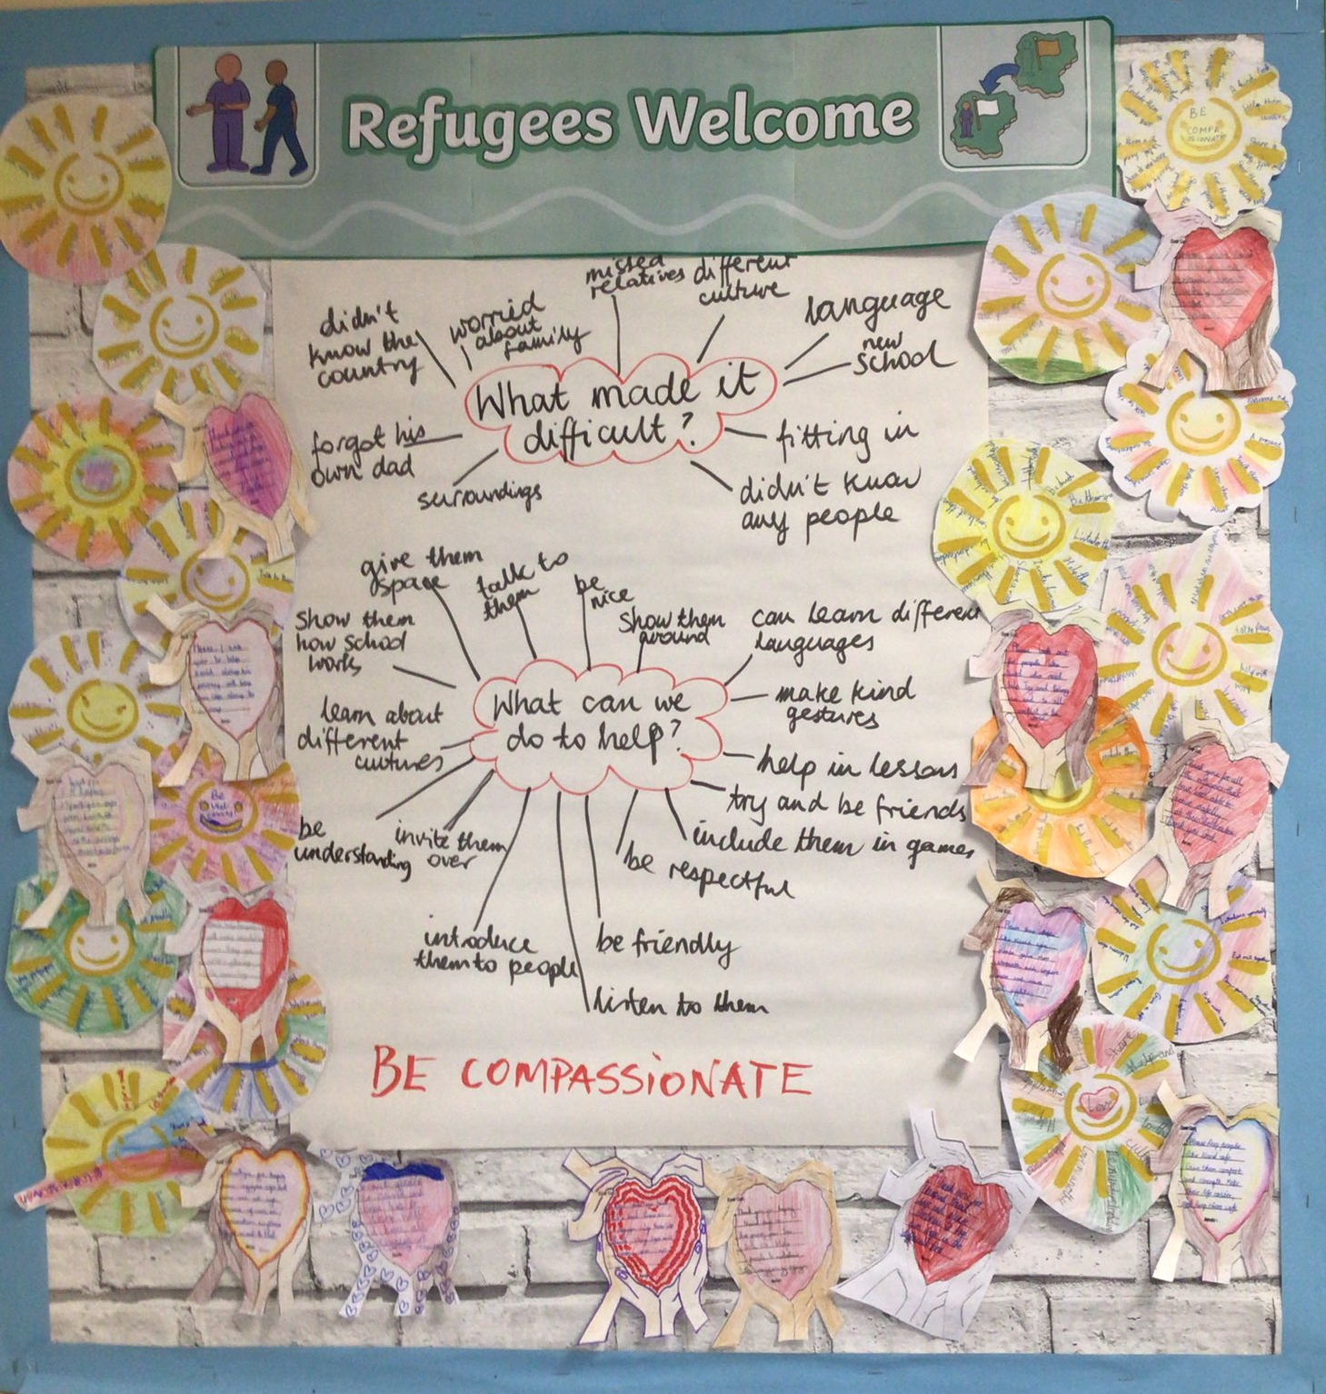
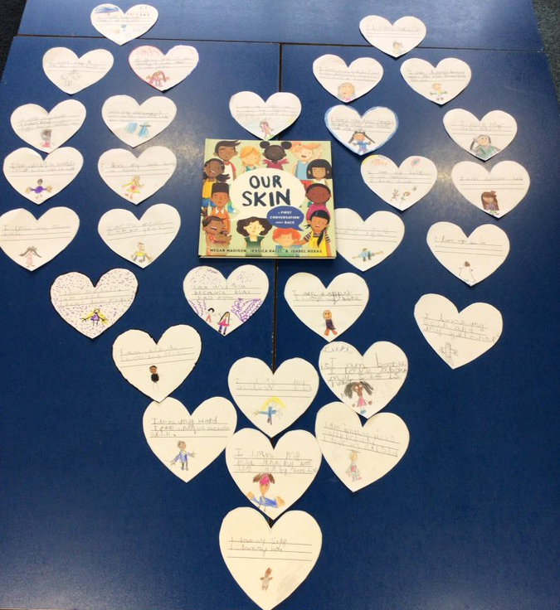
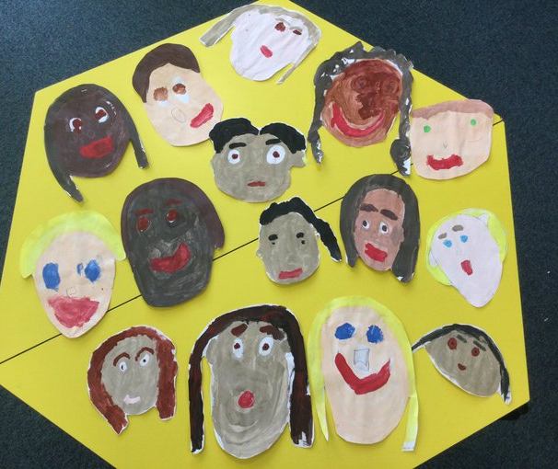
Inclusivity

Slide 8
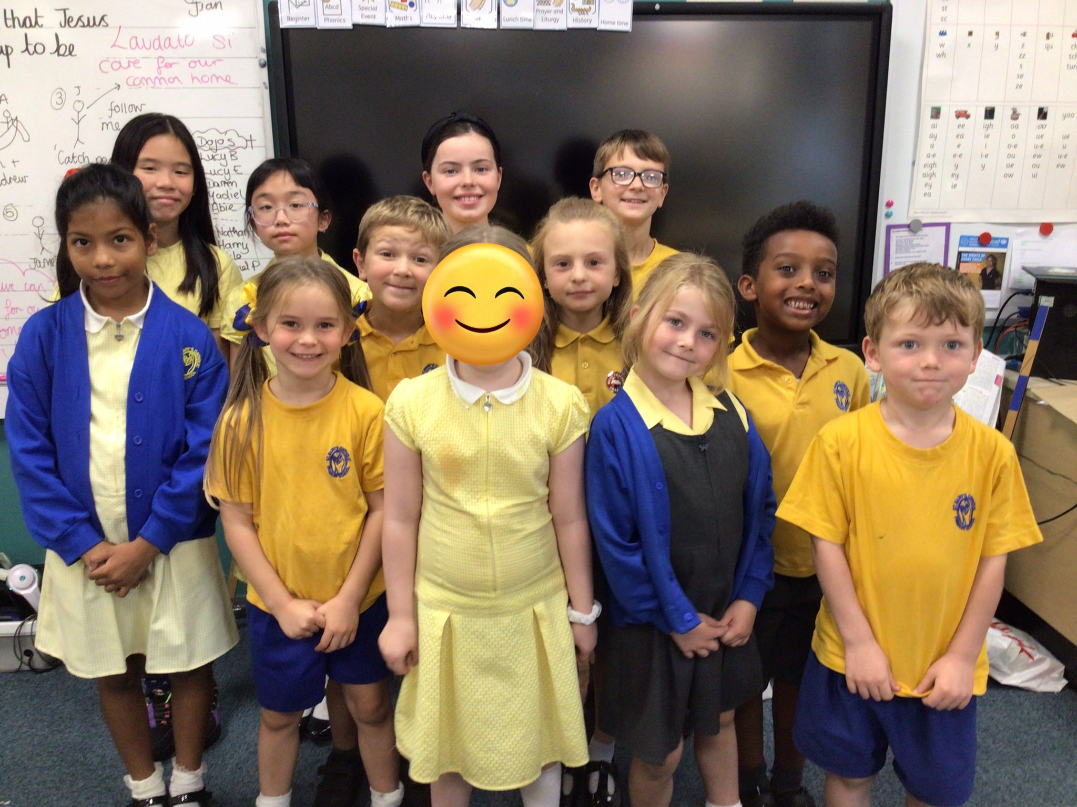
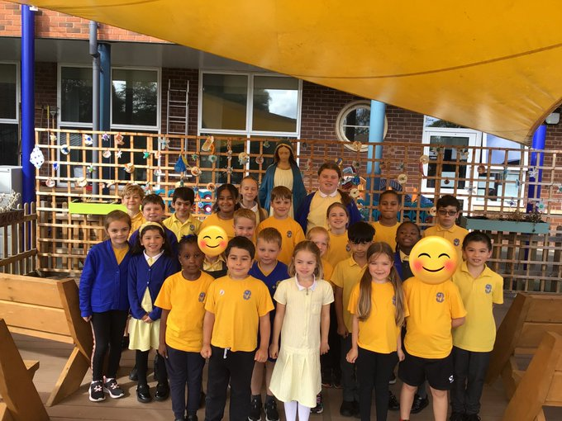
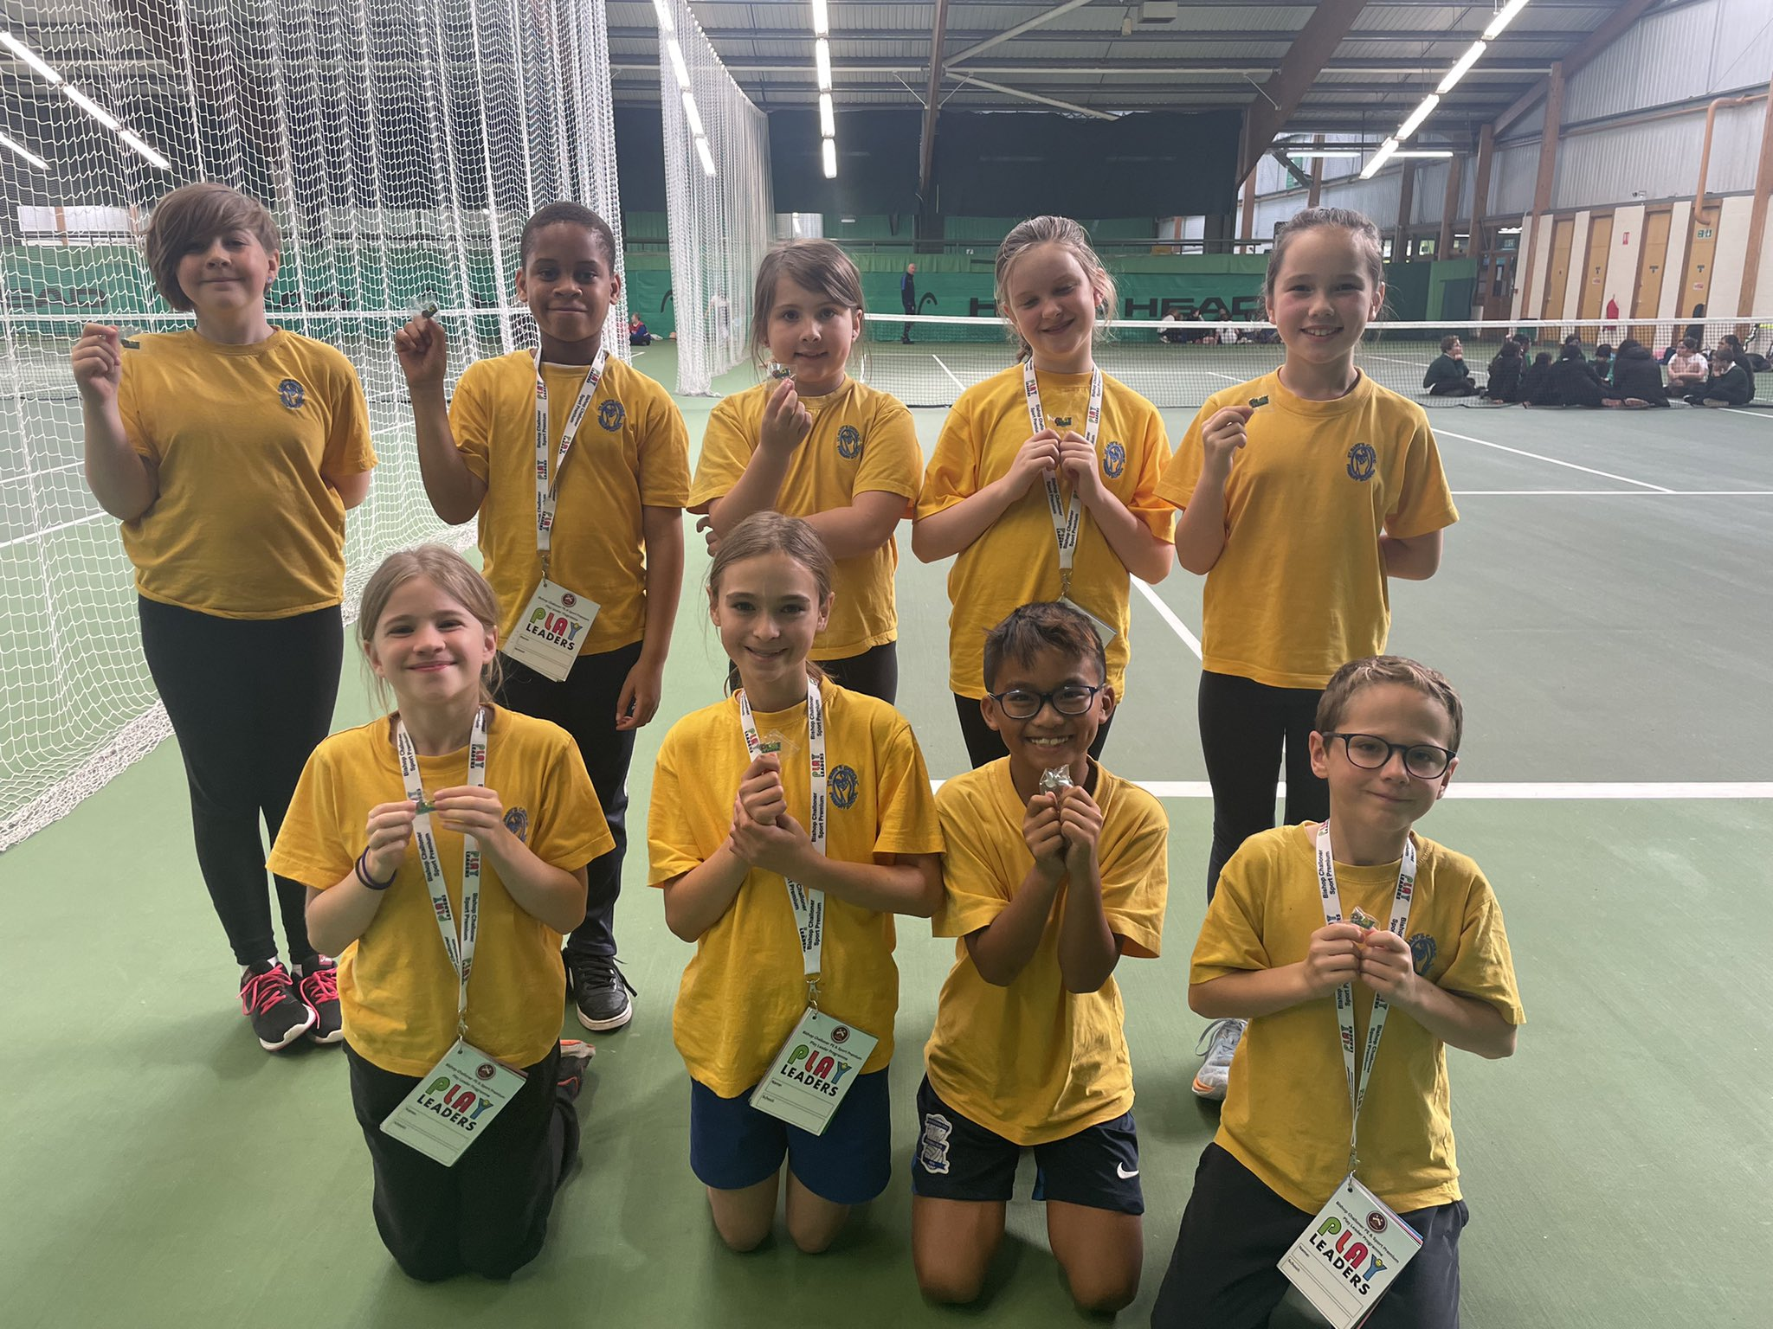
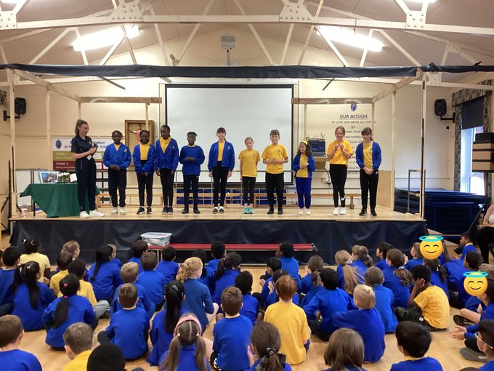
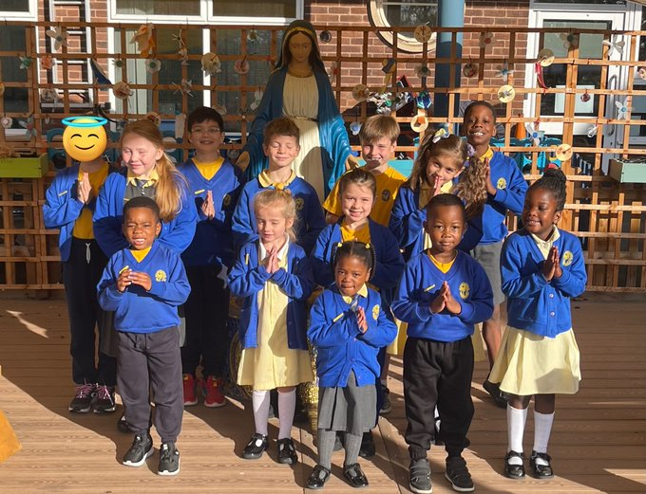
School
Council
Pupils as leaders
Play
leaders
CAFOD
club
Spiritual
Council
Prefects
Head boy/Head girl
House Captains

Slide 9
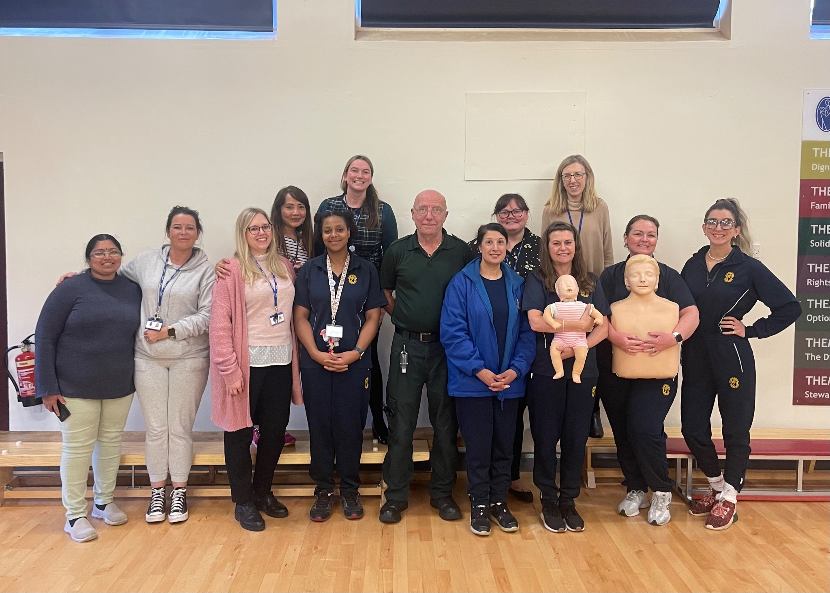
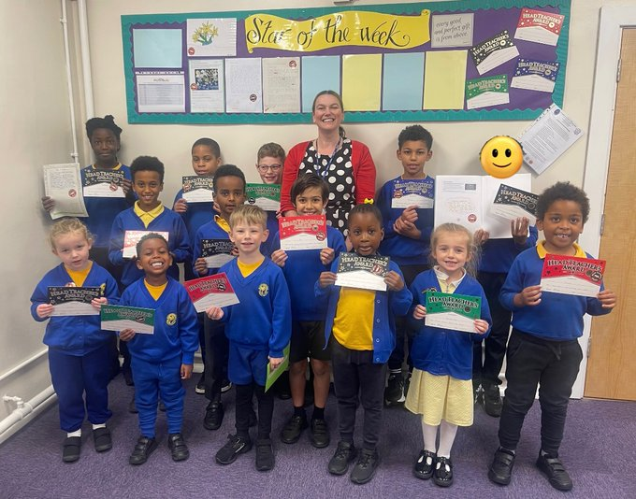
Excellent behaviour, attitudes and pastoral care
DSL Team
Behaviour policy
First-aiders
Rewards

Slide 10
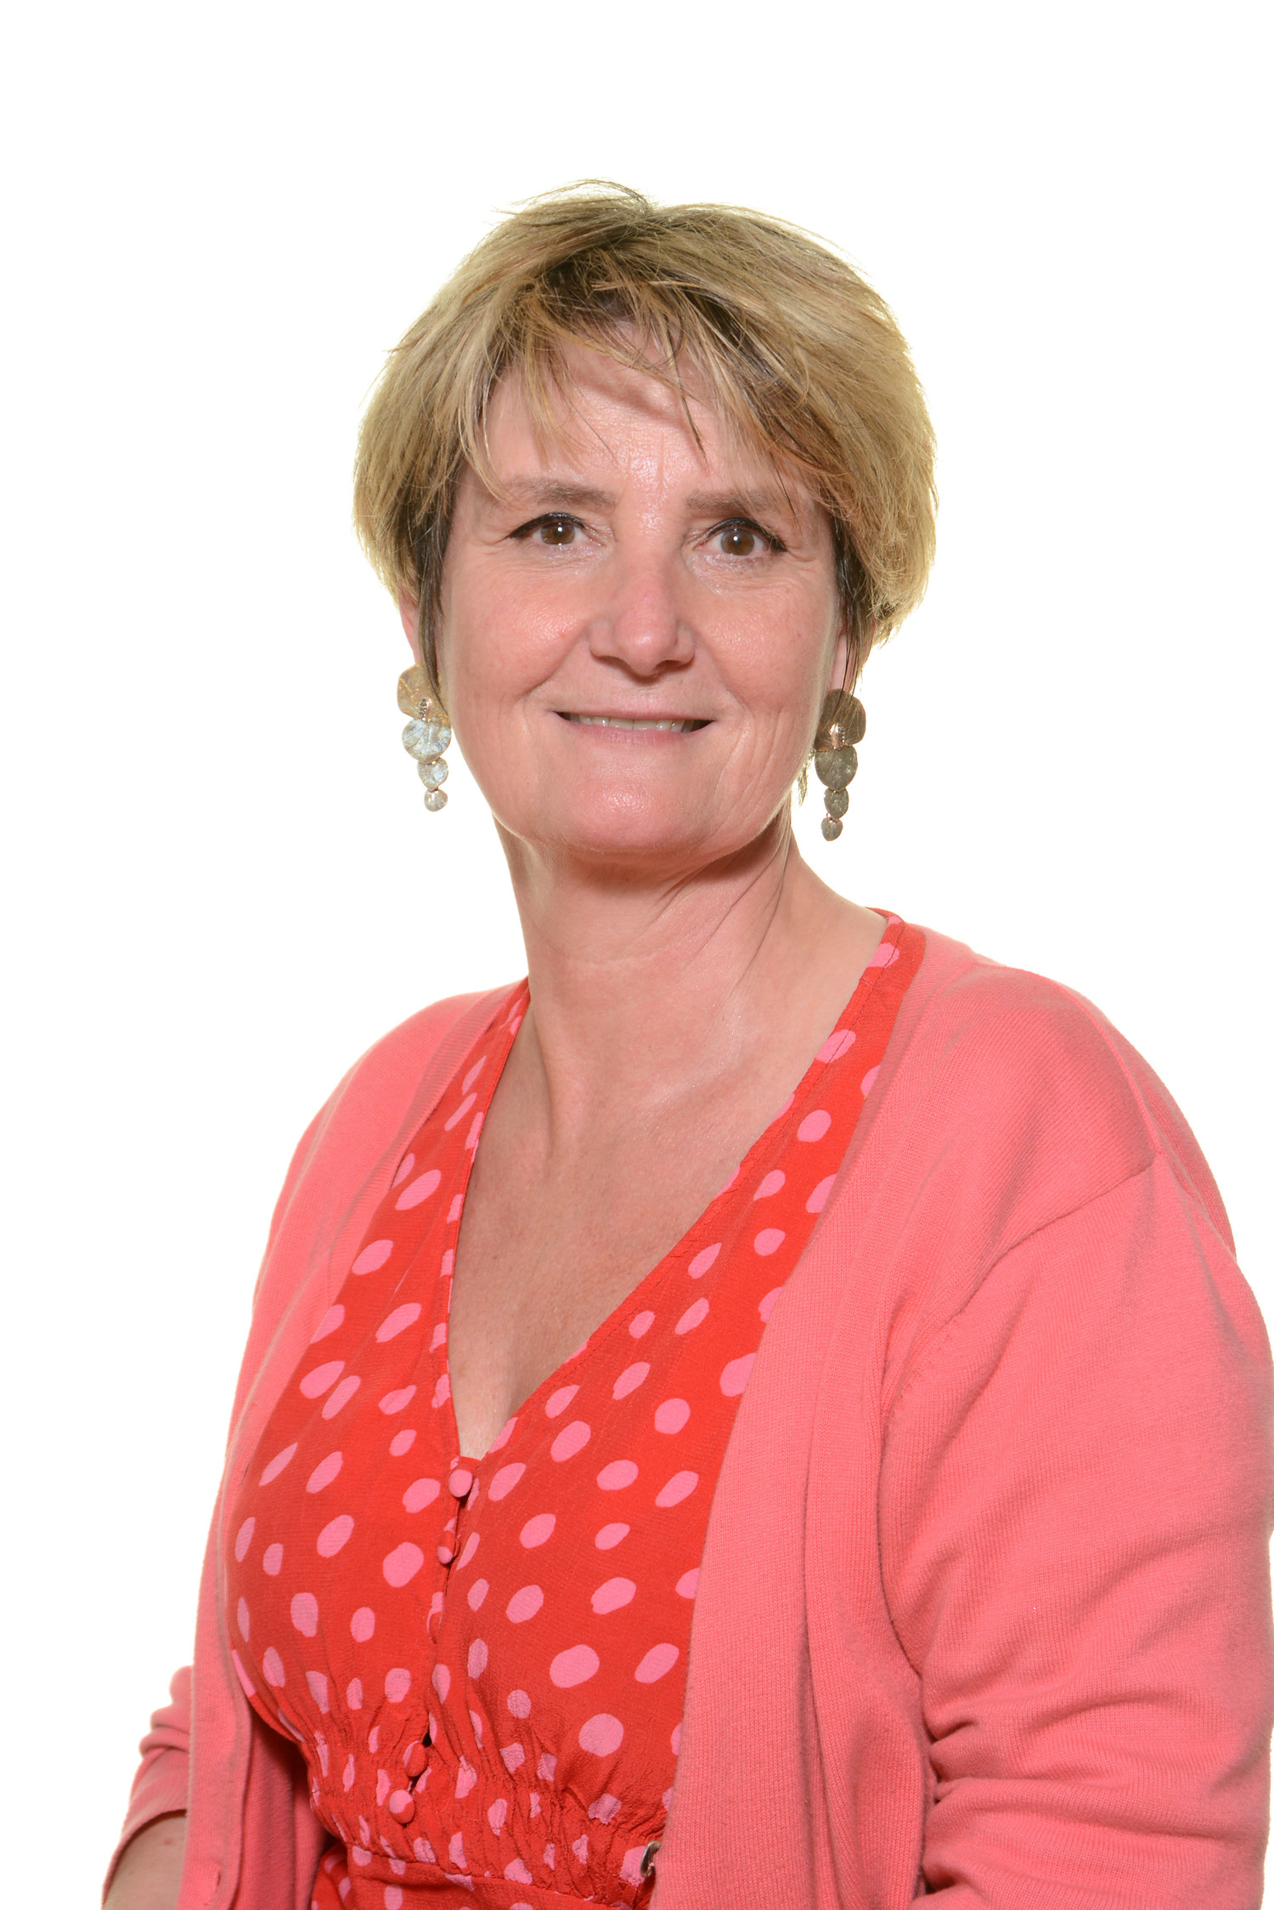
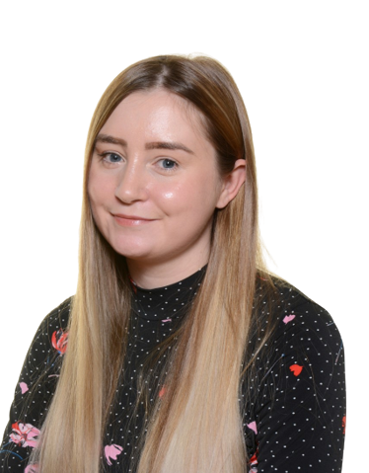
Academic achievements above National
Commitment to all children
achieving their full potential
Madame Baille teaches our art and our French!
PE
Awards
Music opportunities
Our SENDCO is:
Mrs Fowler

Slide 11
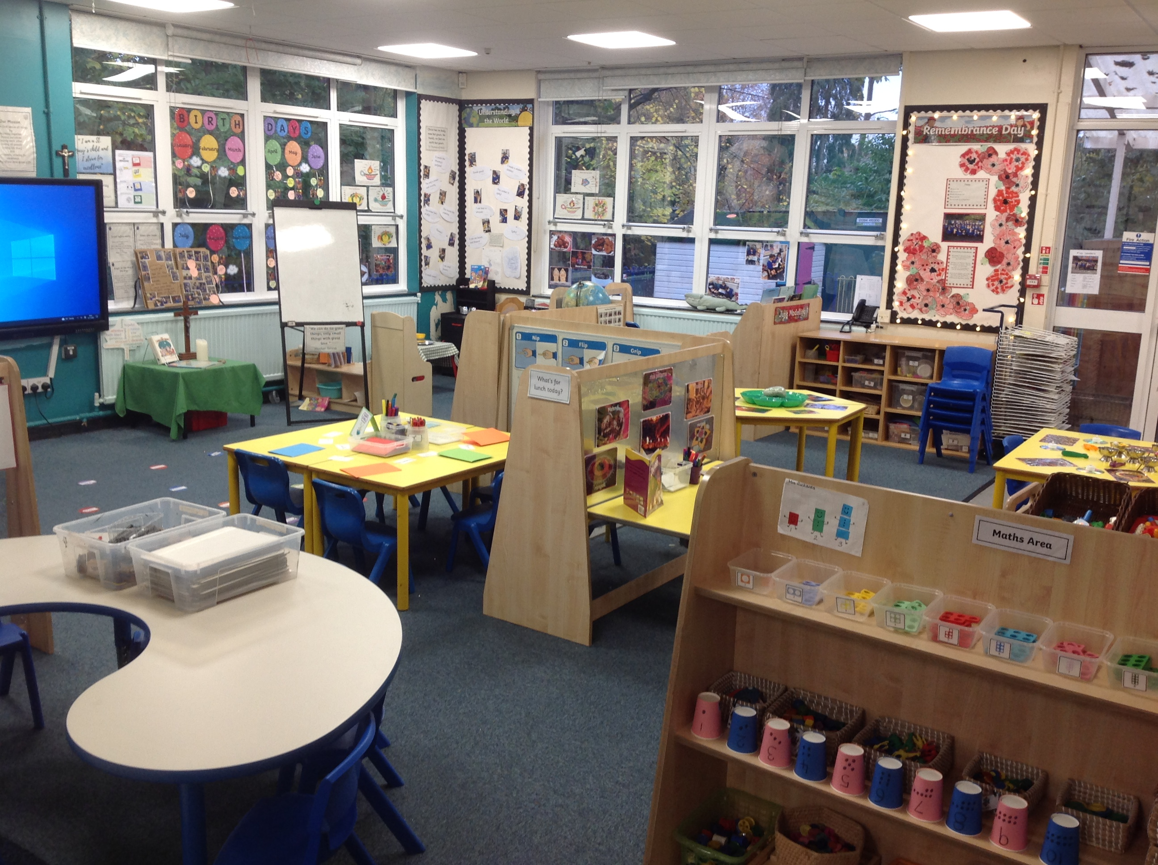
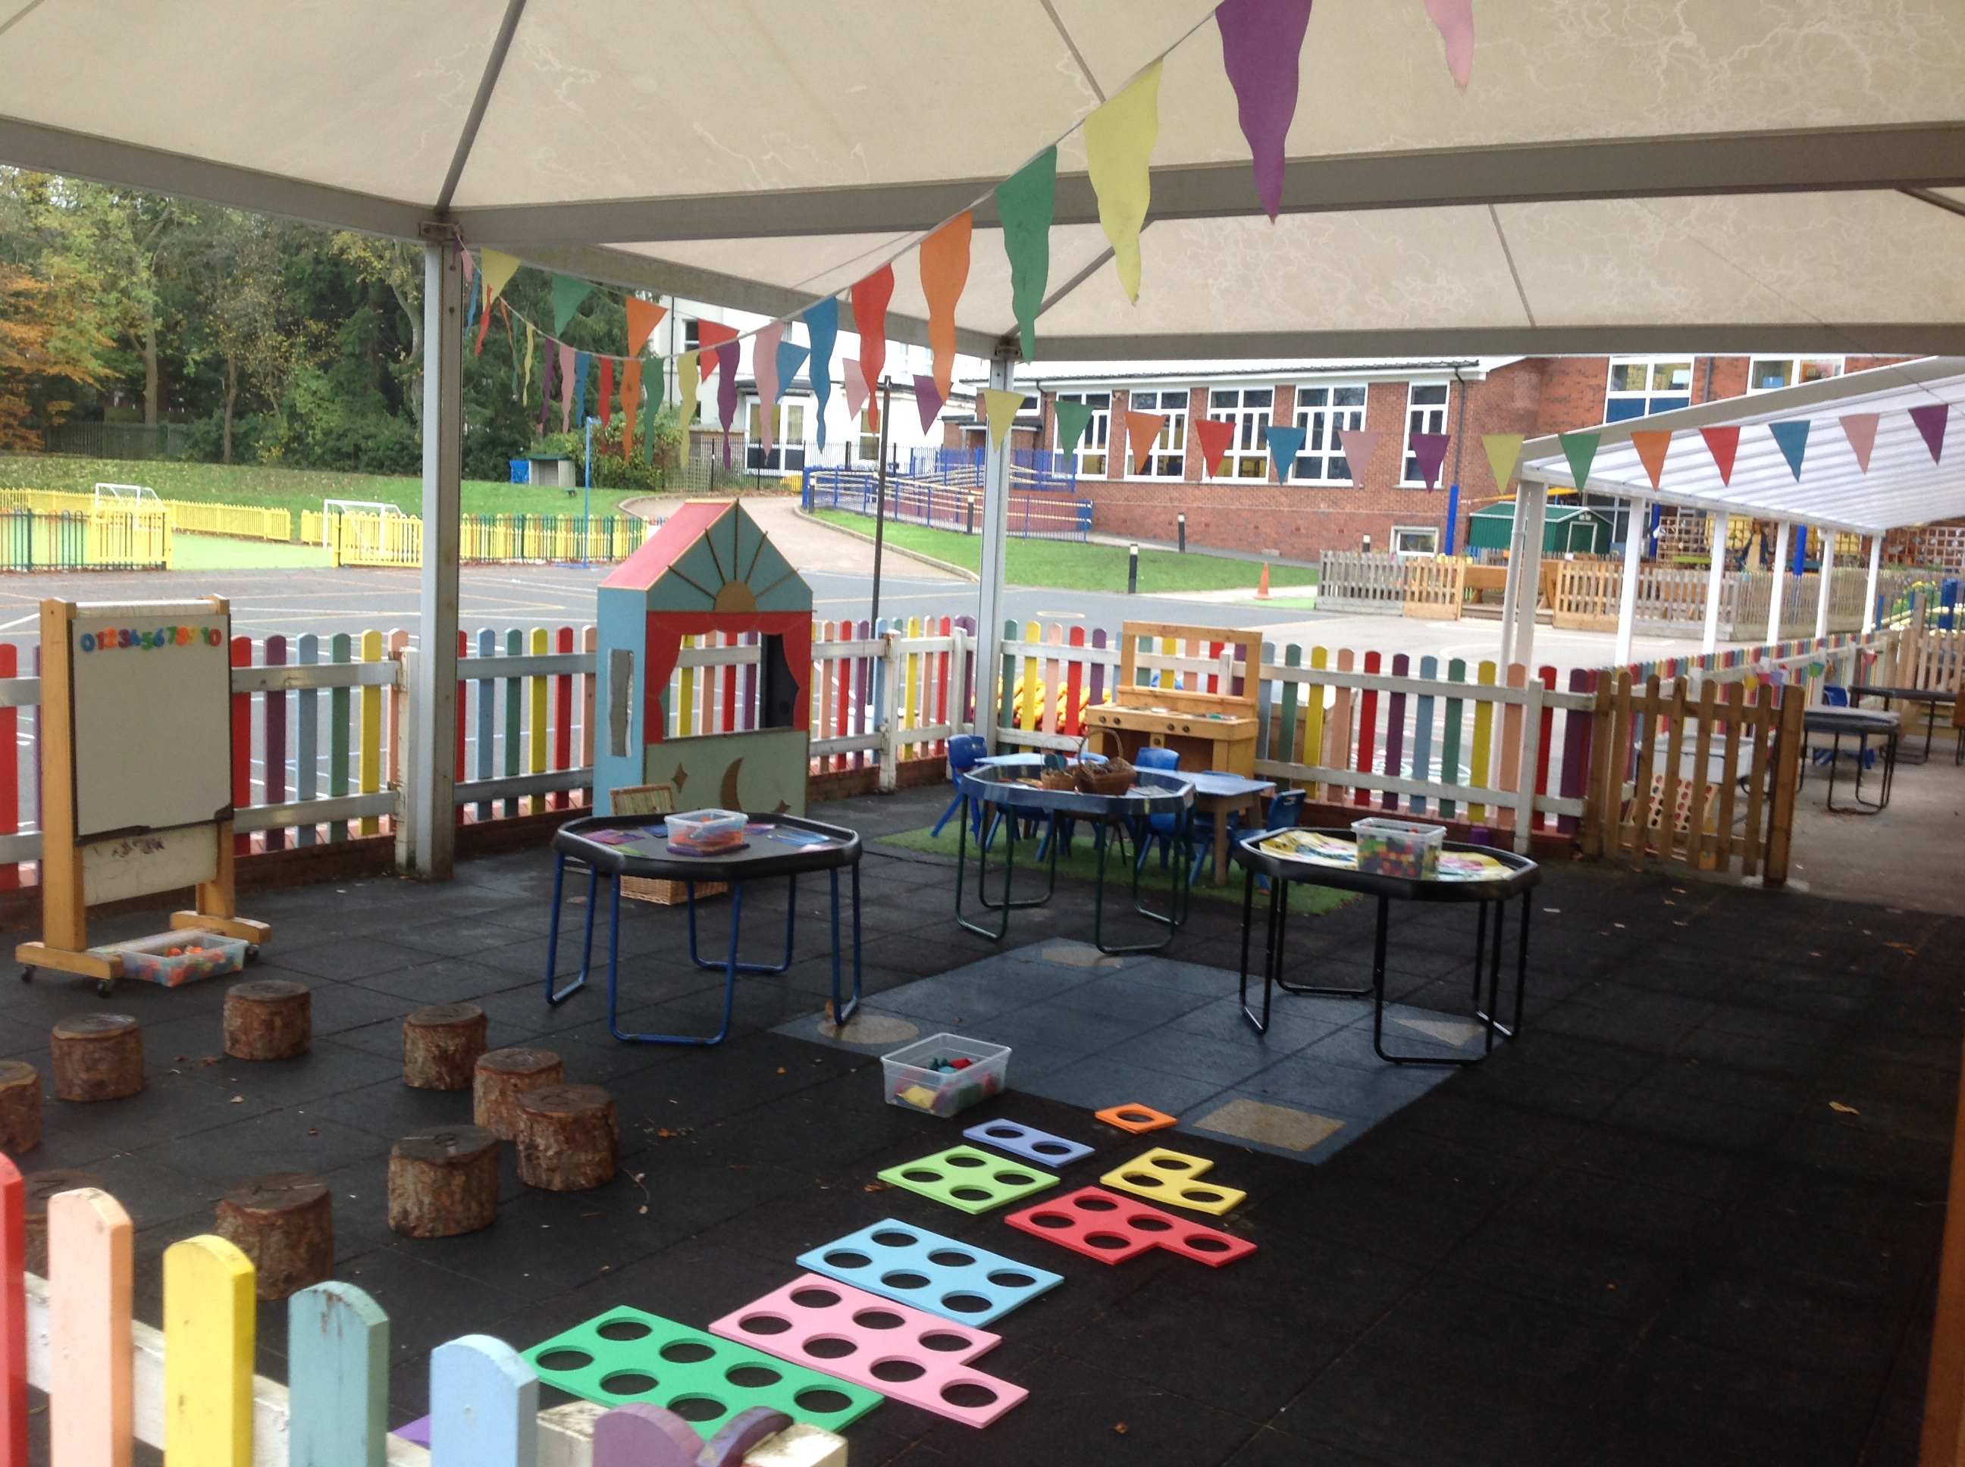
Where it all begins…

Slide 12
What is the EYFS?
Prime Areas | Specific Areas
Communication and Language ELG 1 Listening, attention and understanding ELG 2 Speaking | Literacy ELG 8 – Comprehension ELG 9 – Reading ELG 10 - Writing
Personal, Social and Emotional Development ELG 3 Self Regulation ELG 4 Managing Self ELG 5 Building Relationships | Mathematics ELG 11 – Number ELG 12 – Numerical Patterns
Physical Development ELG 6 Gross Motor Skills ELG 7 Fine Motor Skills | Understanding the World ELG 13 – Past and Present ELG 14 – People, Culture and Communities ELG 15 - The Natural World
 | Expressive Arts and Design ELG 16 – Creating and Materials ELG 17 – Being Imaginative and Expressive

Slide 13
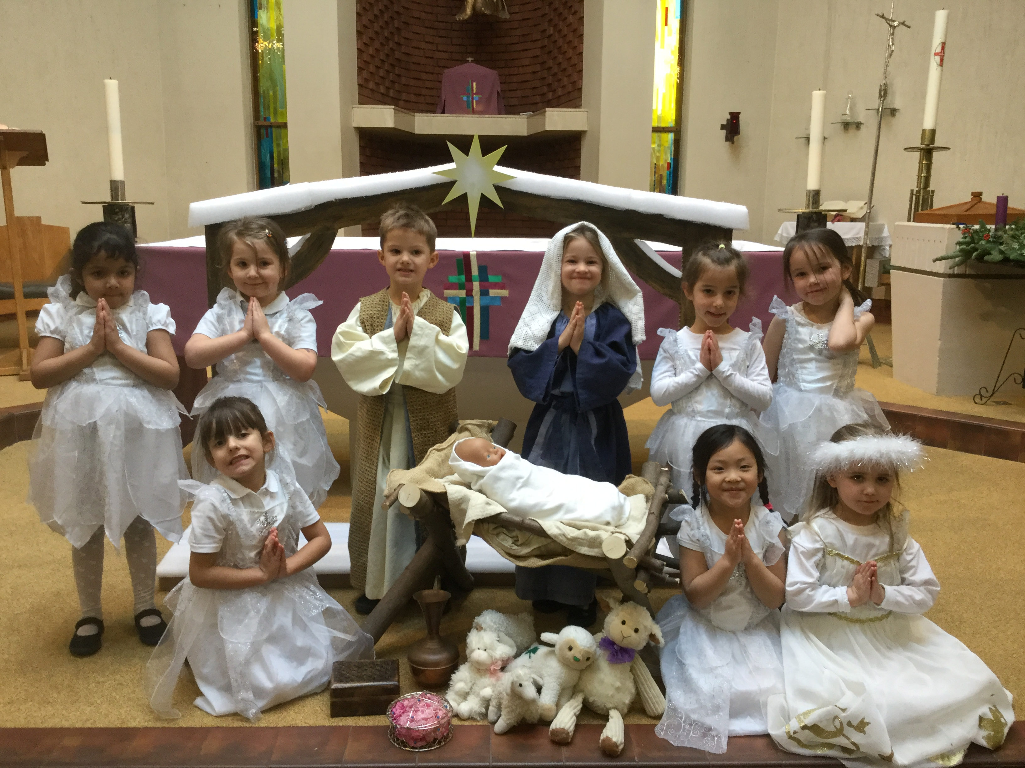
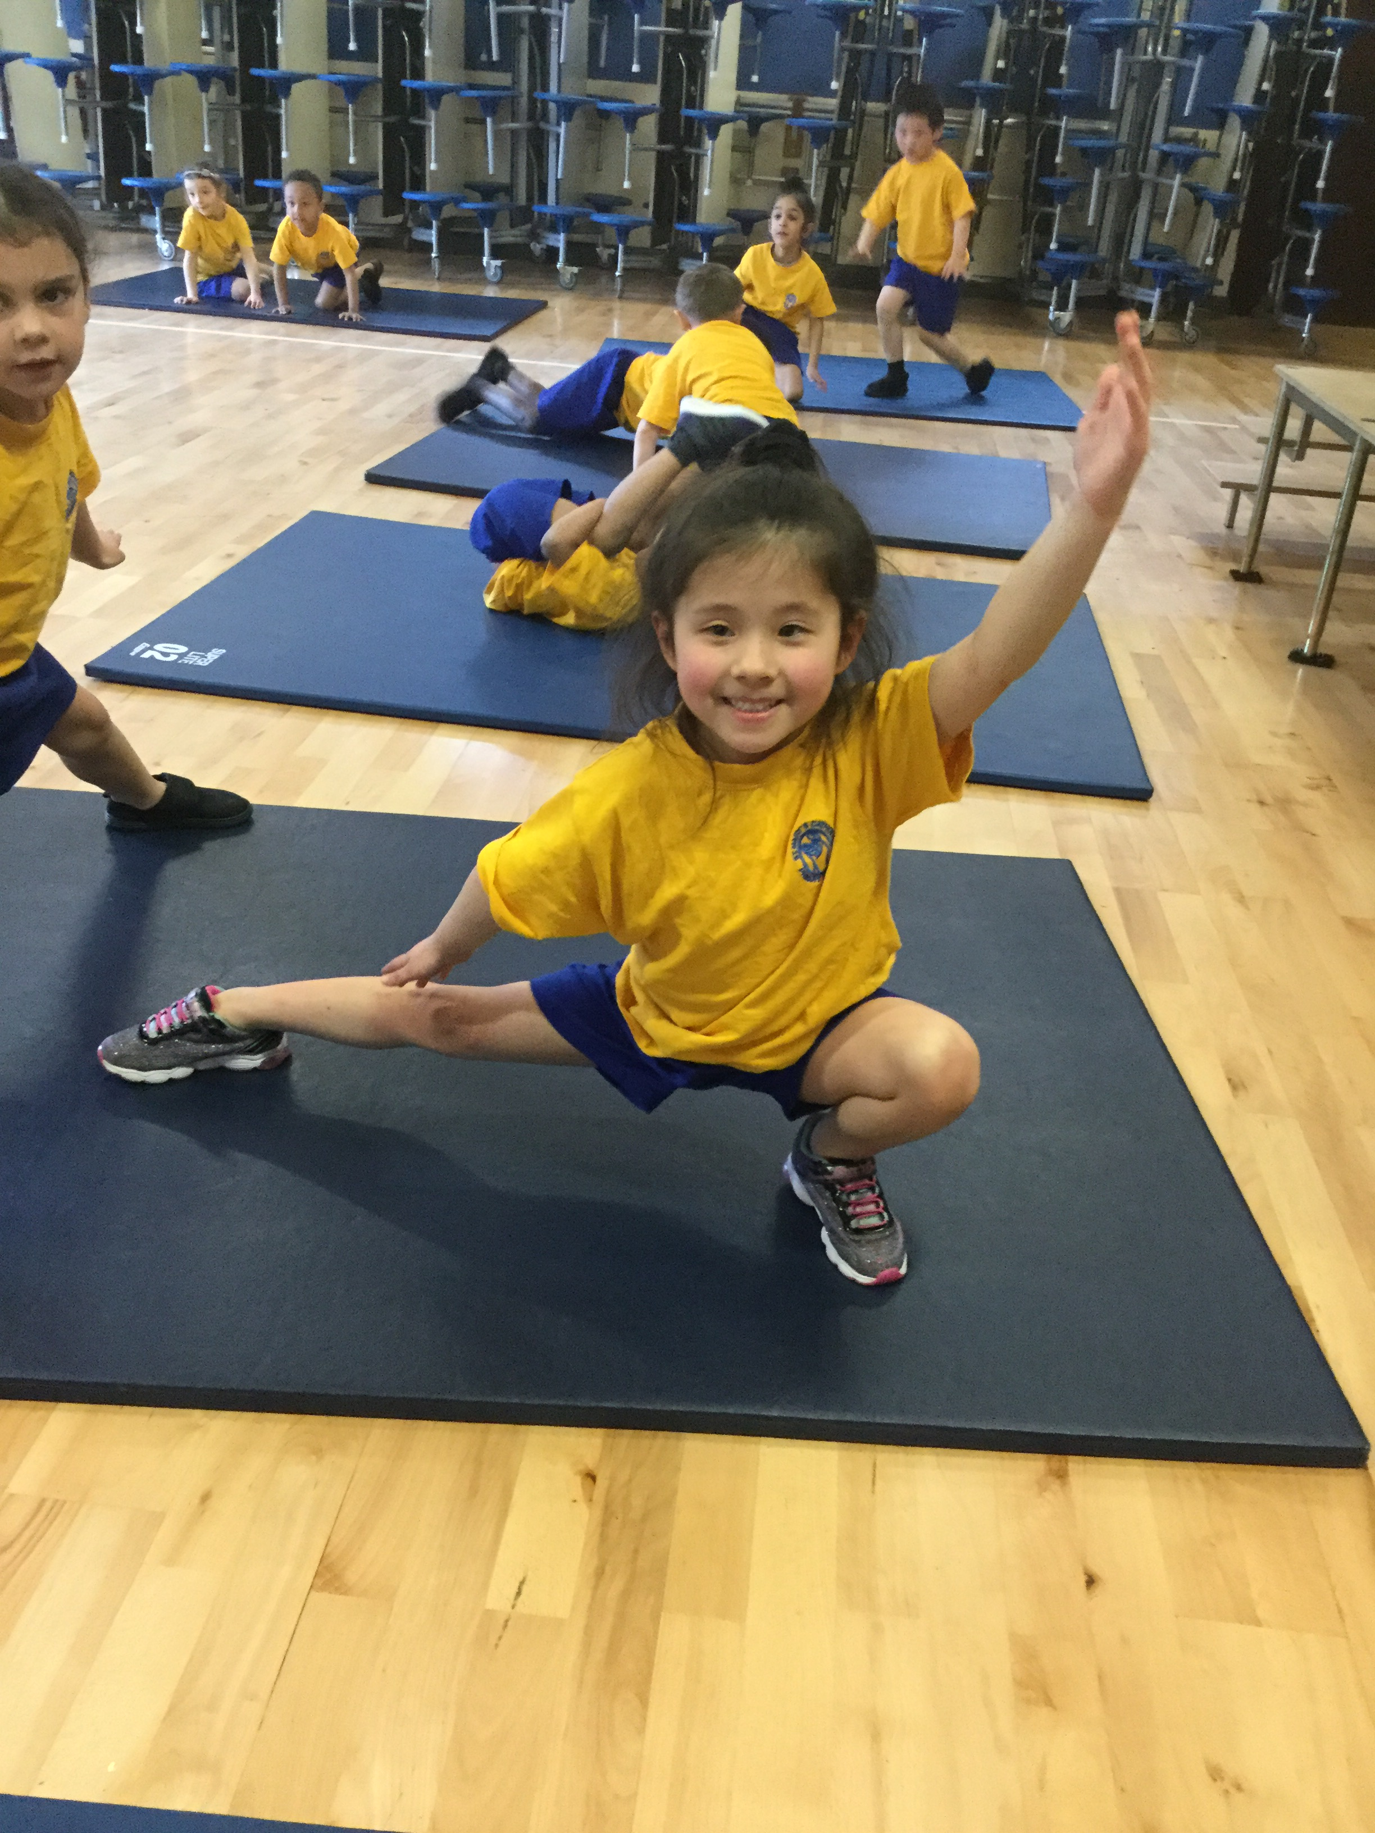
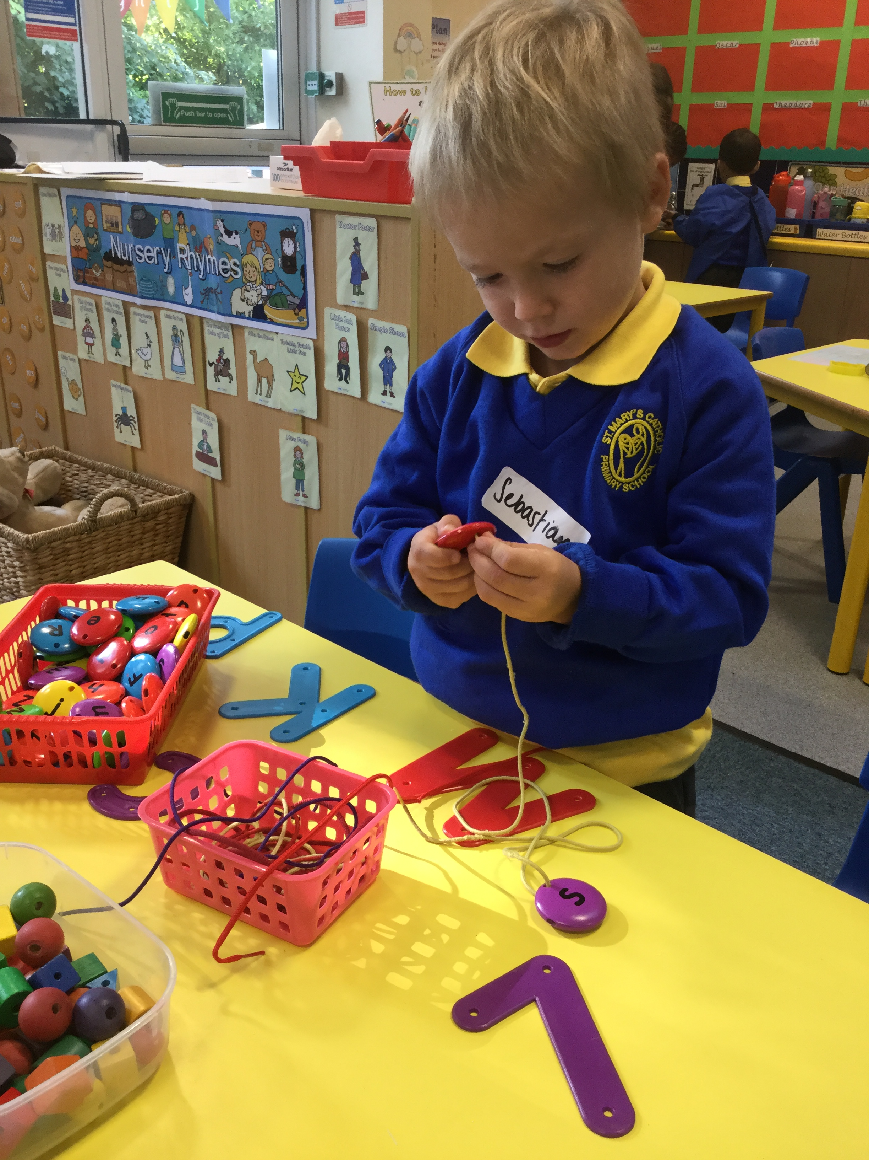
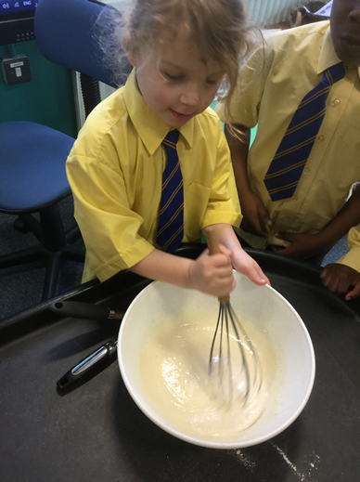
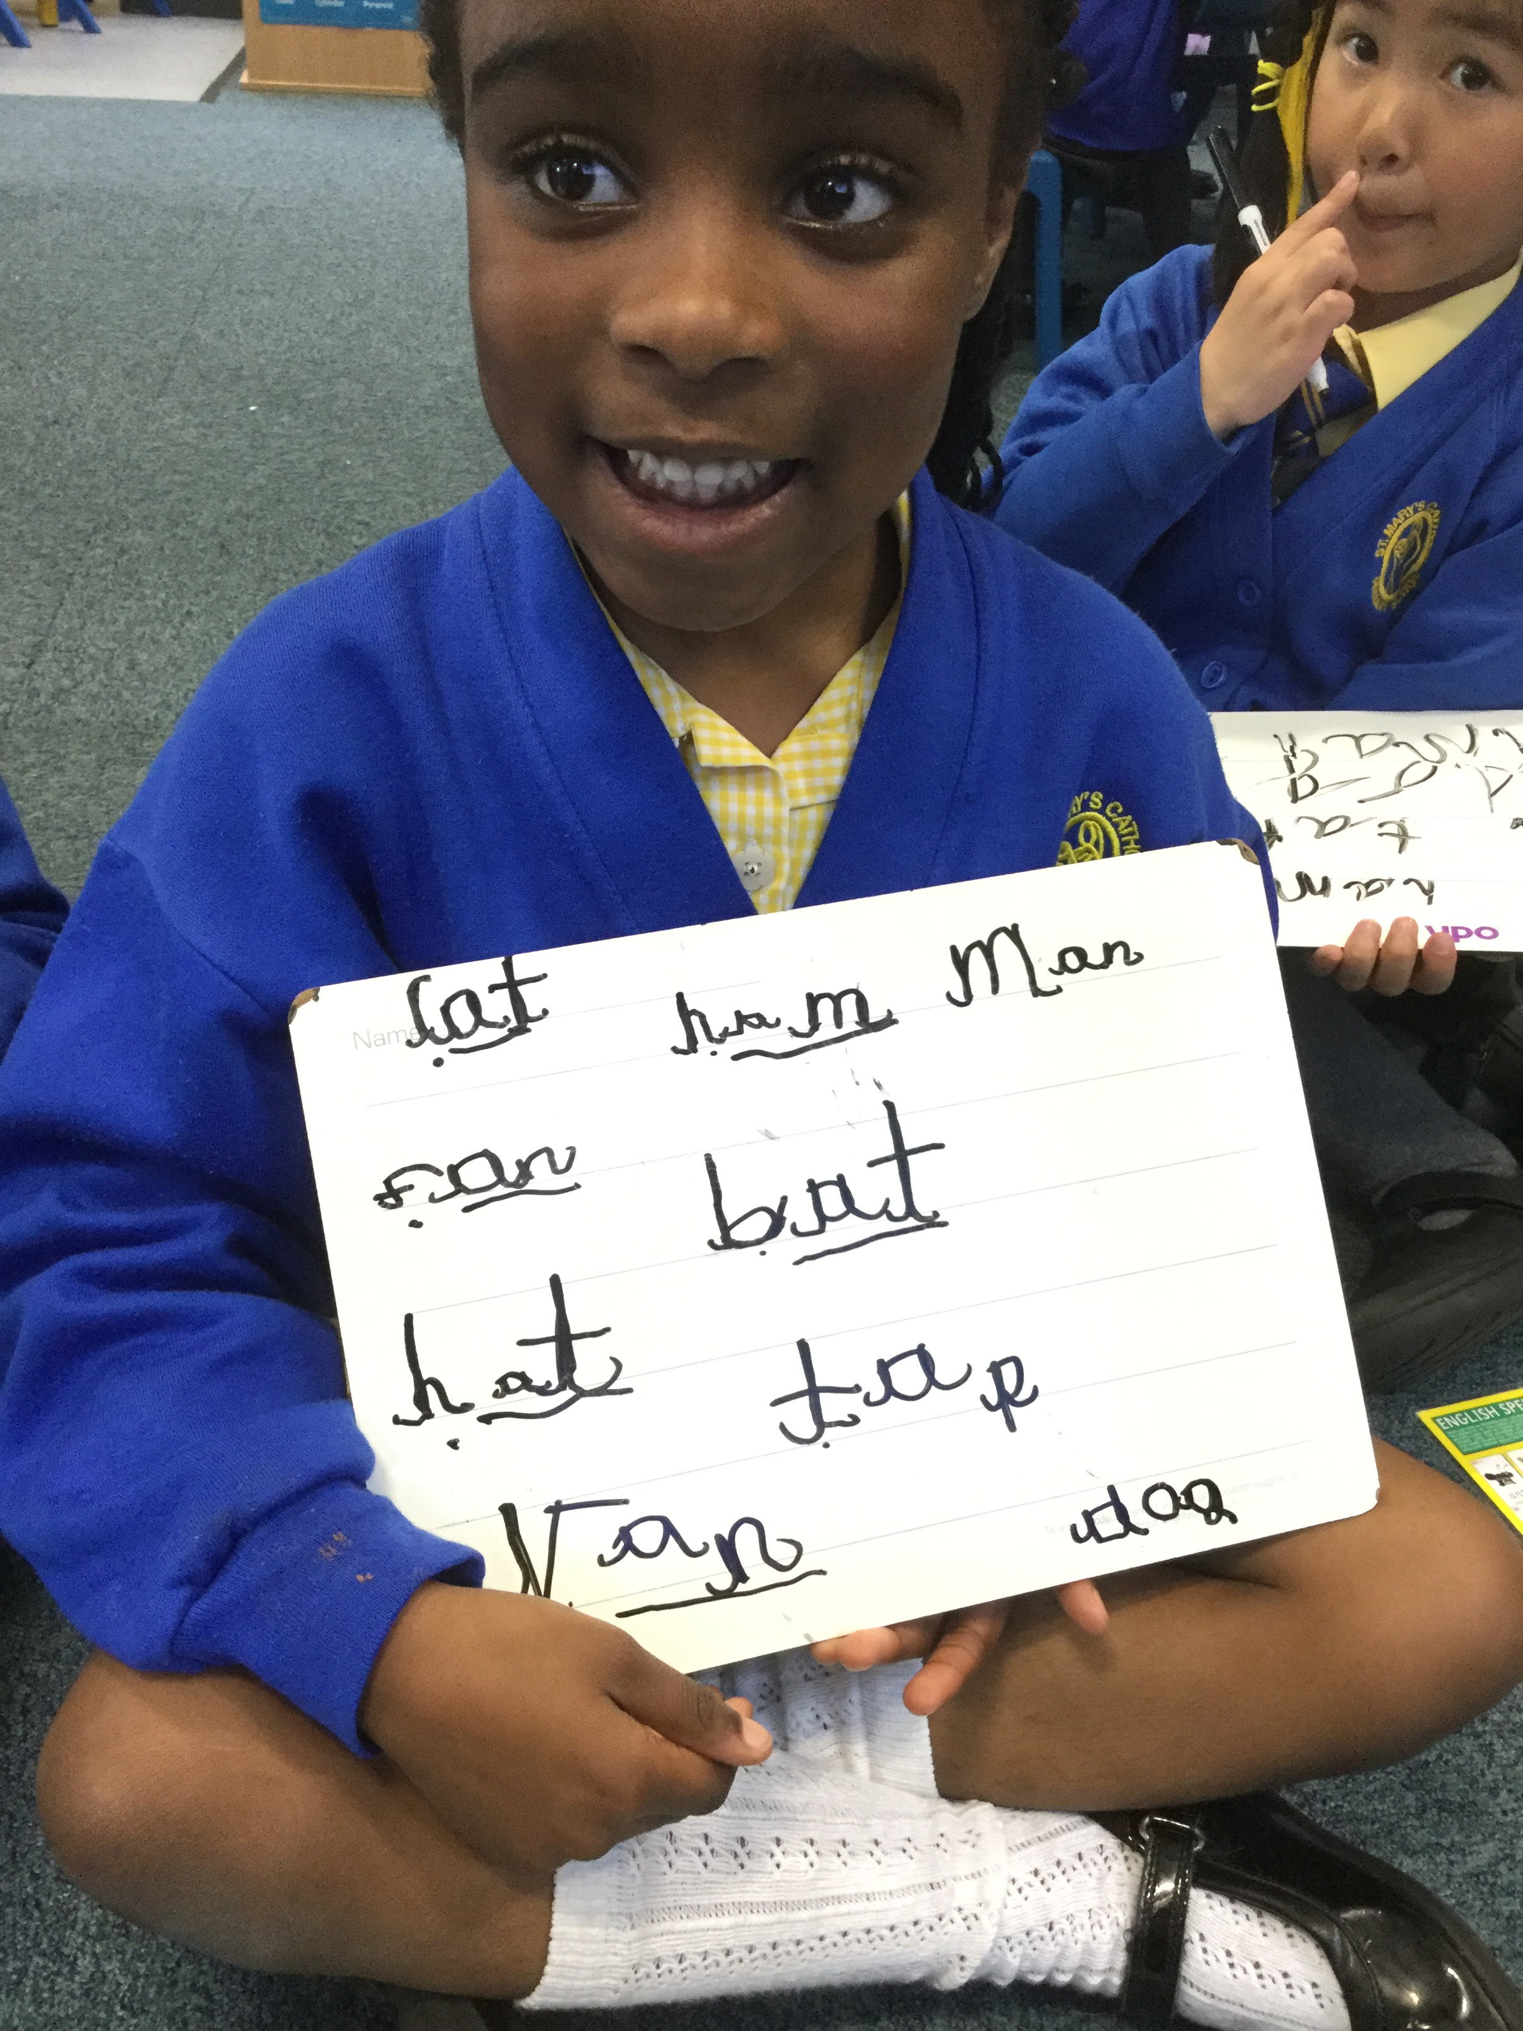
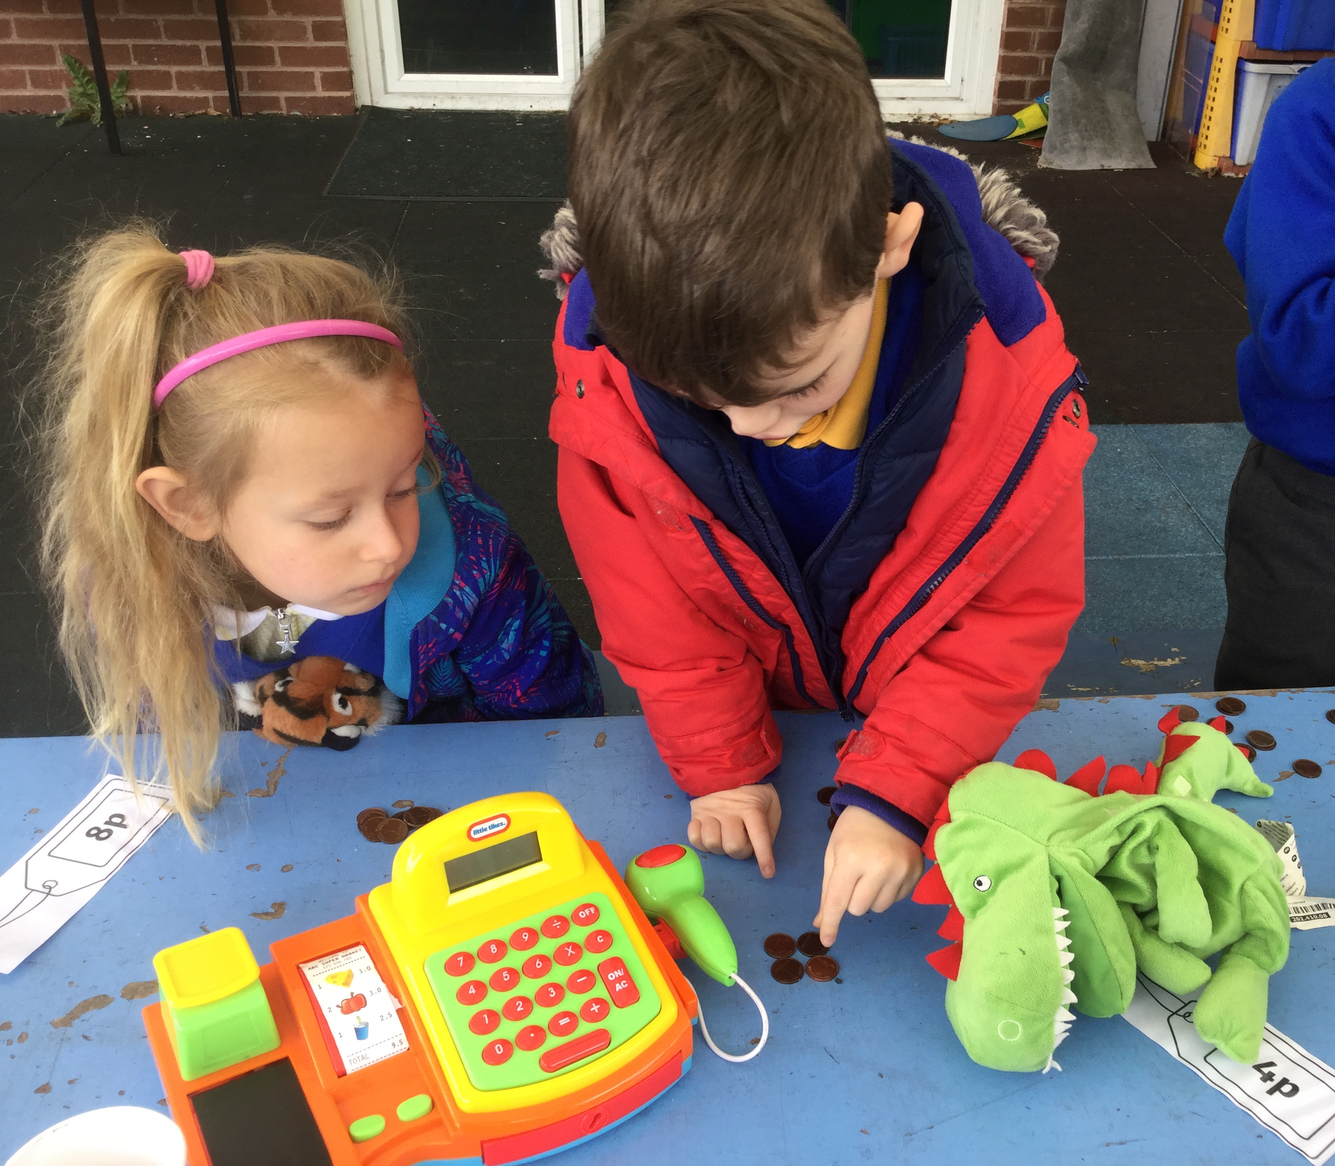
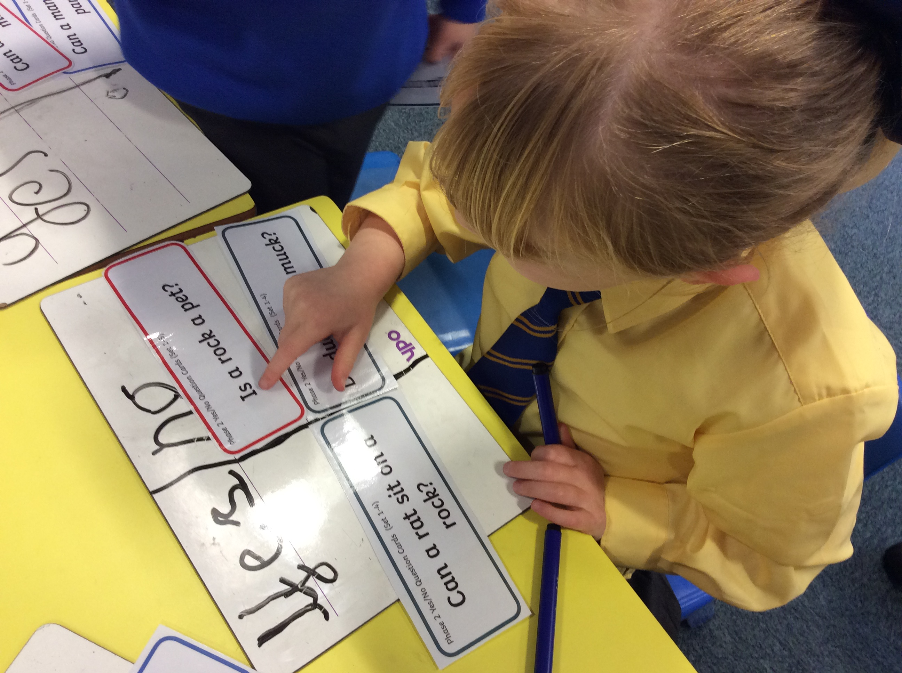
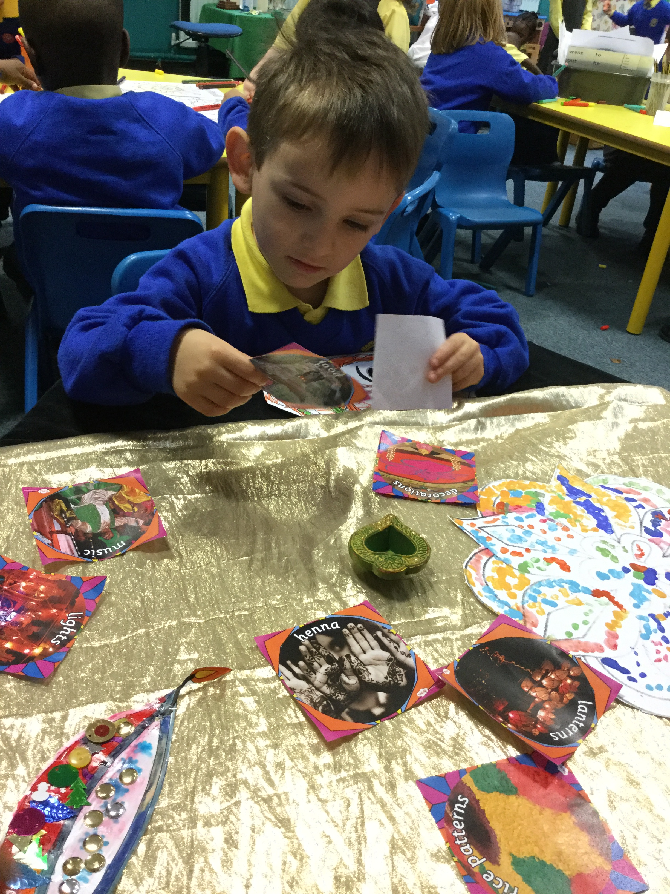
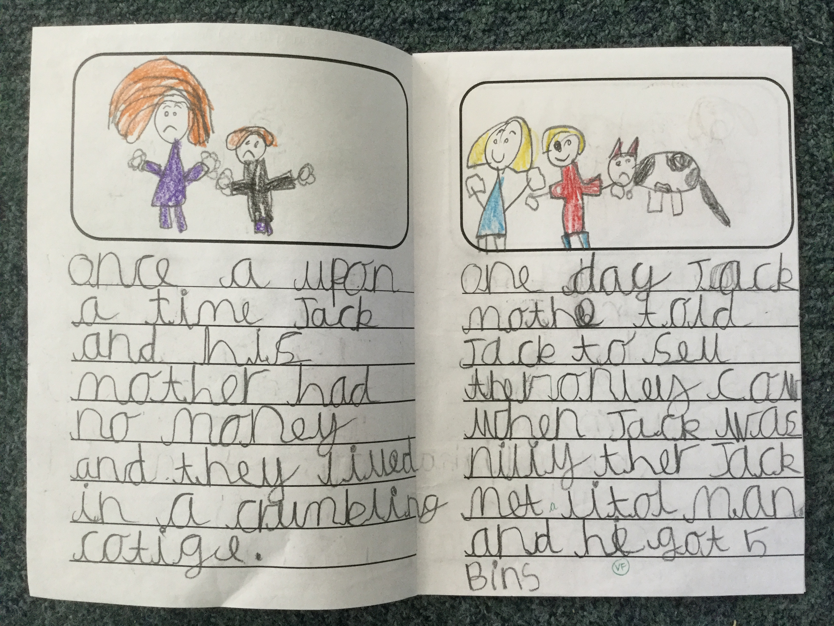
RE
Physical Development
Fine
motor
Arts Design
Literacy:
Reading
and Writing
Maths
The
World

Slide 14
Wrap Around Care
https://www.kidz-comm.co.uk/
Breakfast club:
7.30am – 8:40am
After School club:
3.00pm - 6.00pm
General Manager: Jane Lewis
Phone no: 07736 399 789

Slide 16
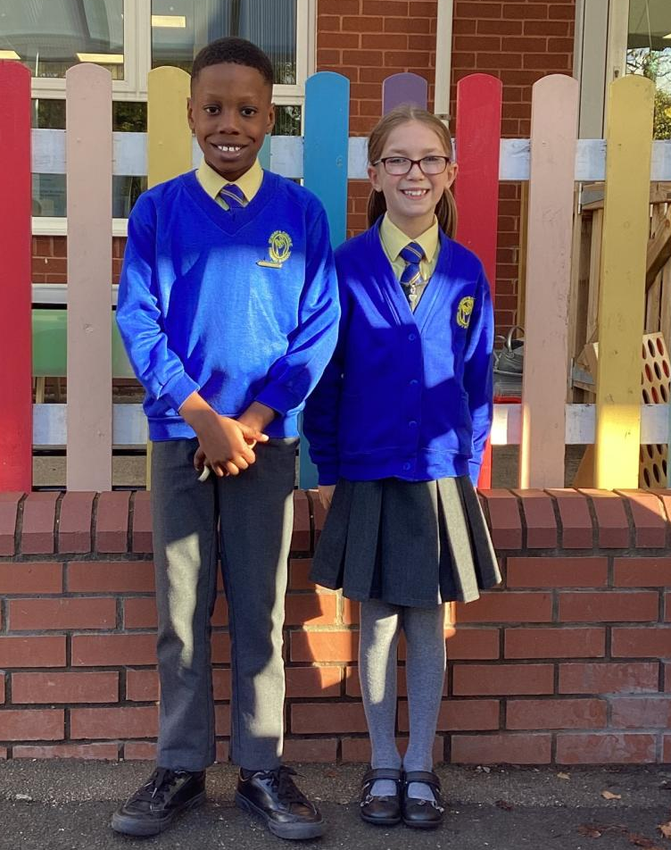
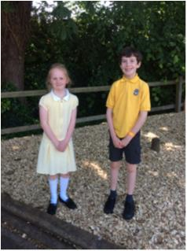
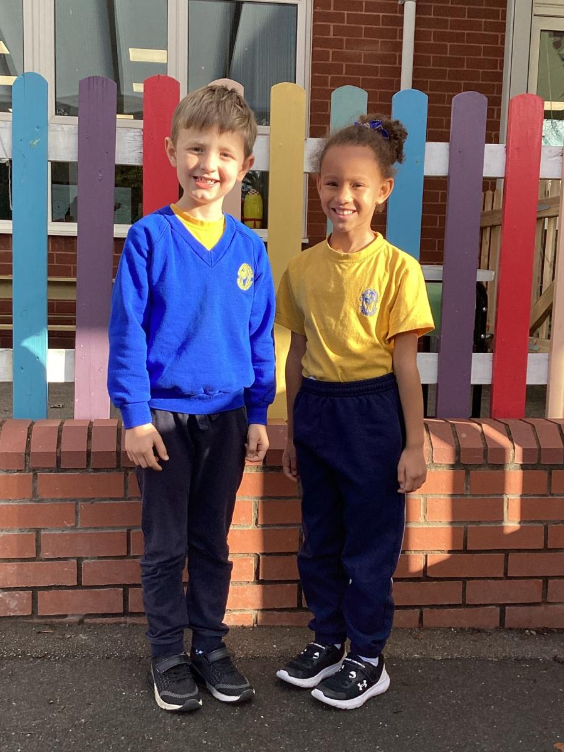
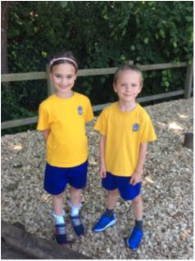
School Uniform

Slide 17
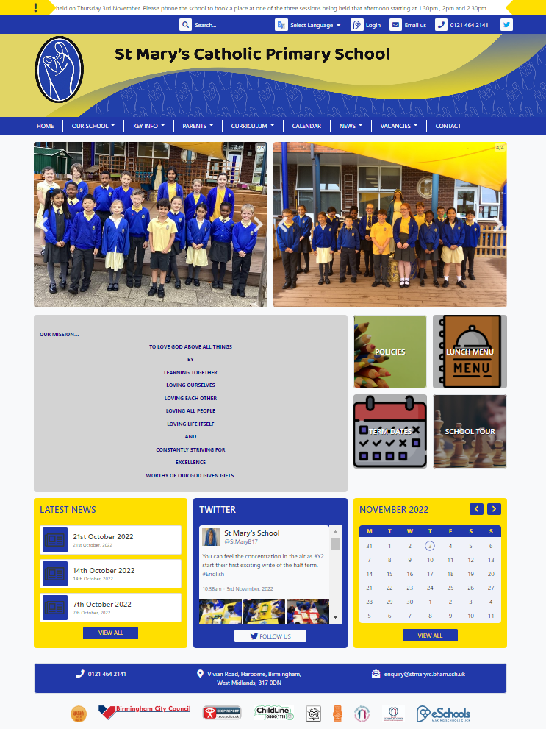
Communication with parents / where to find out more…
Website
www.stmaryrc.bham.sch.uk
Weekly newsletter
From Headteacher
Twitter

Slide 18
What Ofsted think of our school
“Leaders’ ambition to ensure that all pupils achieve well is realised. Children get off to a strong start in learning to read, write and count in the early years.”
“Pupils behave well. They are polite and well-mannered, and they work hard. They have a firm understanding and appreciation of differences.”
“Pupils are happy and enjoy coming to school. Parent, staff and pupil questionnaire responses endorse that pupils feel safe. This is because pupils are well cared for by staff.”
Ofsted, January 2023

Slide 19
What parents think of our school
“I think St Mary’s is a fantastic school. Every time I have come into the school, I have always been impressed with the calm and purposeful atmosphere and the attitude of staff and pupils. My child is very happy here. I am enjoying the twitter activity this year and the chance to see so much of the daily life of each class. Thank you to all the staff who work so hard.”
“The staff are wonderful, caring and experienced. I am confident that they have the best interests of our children in mind. Our children are very happy at St. Mary’s.”
“Thank you to the staff for the wonderful teaching you are providing, you really treasure and nurture each child. There is open and constructive dialogue between parents and the staff.”
“We are really happy with the progress our child is making and the quality and care of the teaching staff, thank you.”
“Thank you. For all the opportunities for my children. Staff work so hard. We love St Mary’s!”
“I'm so grateful that my child has a place here. Thank you all so much for everything you do. Teachers change lives!”

